Slide 1

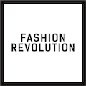
FASHION
REVOLUTION
WEEK
20-26 April 2020
-
Use your voice.
Ask brands
#WhoMadeMyClothes?
www.fashionrevolution.org
Notes:
Fashion Revolution is a movement which wants to make the clothing industry fairer for everyone involved.
This Powerpoint is an introduction to Fashion Revolution and its key messages for you to use in the classroom and is useful as a starting point for any other Fashion Revolution educational resources. We have provided accompanying notes but feel free to adapt them to your own requirements.

Slide 2
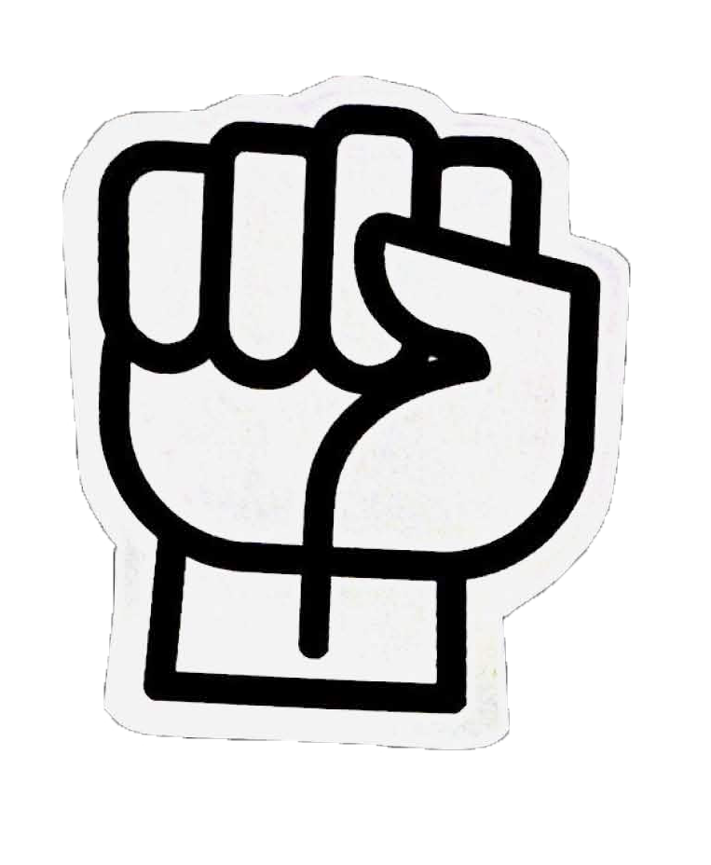
WE ARE FASHION REVOLUTION
We believe in a global fashion industry that conserves and restores the environment and values people over growth and profit.
Notes:
Fashion Revolution is a global movement that wants to change the way the fashion industry works.
It invites designers, academics, writers, business leaders, policymakers, brands, retailers, marketers, producers, makers, workers and fashion lovers to be involved.
Fashion Revolution believes that positive change can happen if we all think differently about fashion and demand better. It campaigns for a cleaner, safer, fairer, more transparent and more accountable fashion and textiles industry.
It wants fashion to become a force for good – an industry that values people and planet over profit and growth.

Slide 3
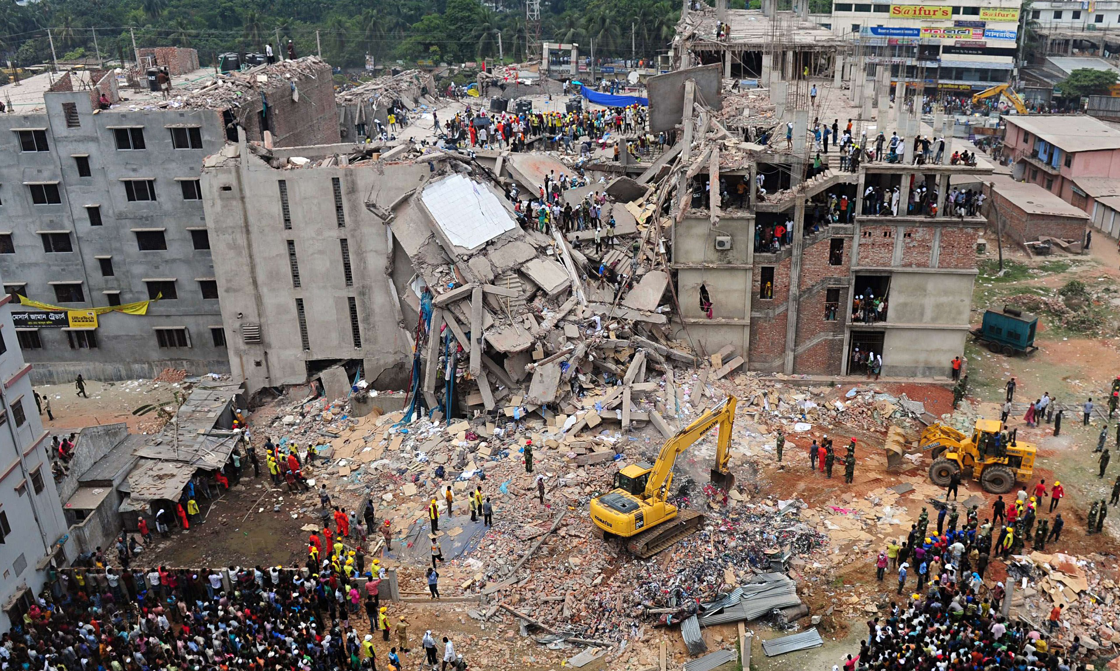
Notes:
On 24 April 2013 a garment factory in the Rana Plaza complex in Bangladesh collapsed. There were five garment factories in Rana Plaza all manufacturing clothing for the western market. The victims were mostly young women.
This is how Fashion Revolution started – we came together to campaign for a safe and fair fashion industry so that Rana Plaza never happens again.
Fashion Revolution week takes place every year in April, around the anniversary of Rana Plaza, to bring people together to demand a better fashion industry.

Slide 4
WHAT ARE THE
ISSUES IN THE
FASHION INDUSTRY?
Notes:
Fashion Revolution is a global movement that wants to change the way the fashion industry works.
It invites designers, academics, writers, business leaders, policymakers, brands, retailers, marketers, producers, makers, workers and fashion lovers to be involved.
Fashion Revolution believes that positive change can happen if we all think differently about fashion and demand better. It campaigns for a cleaner, safer, fairer, more transparent and more accountable fashion and textiles industry.
It wants fashion to become a force for good – an industry that values people and planet over profit and growth.

Slide 5

CONSUMPTION
Current estimates suggest that 150 billion
new items of clothing are produced annually.
Source: Sustainable Apparel Materials, 2015.
Notes:
Global fashion consumption continues to gain speed at unsustainable levels and relies on a culture of disposability. Around the world, we produce too much clothing, from harmful materials, much of which ends up incinerated or in landfill.
We must rethink the nature of fashion consumption, adopting new ways of engaging with fashion, and calling on brands to rethink linear business models, honouring those who make our clothes and treasuring the clothes we own.

Slide 6
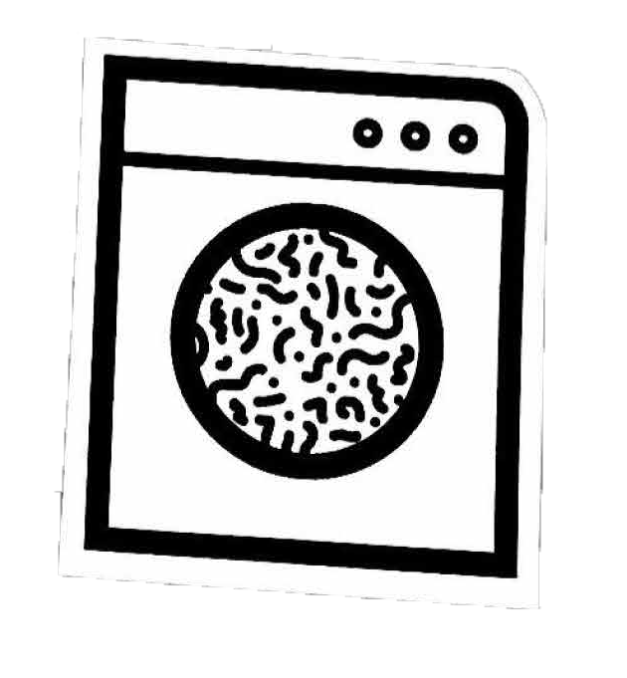
COMPOSITION
Producing plastic-based textiles uses approx.
342 million barrels of oil each year.
Source: Ellen MacArthur Foundation, 2017.
Notes:
The textiles we wear are made from precious natural resources and generate massive environmental impacts in their production.
Plasticbased materials that now comprise the majority of our clothes are shedding microfibres into waterways and endangering human health and nature’s ecosystems. And, many of the fibres we wear use harmful chemical processes in dyeing and finishing, which comprises the health of worker and wearer.

Slide 7
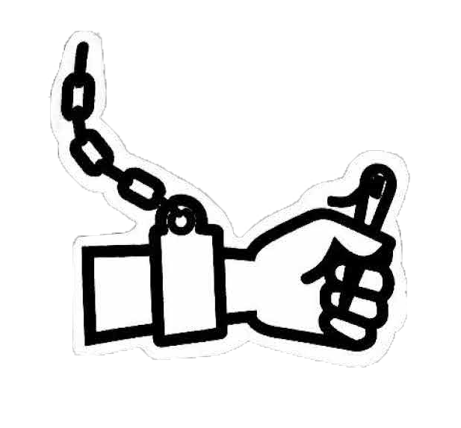
CONDITIONS
77% of UK retailers believe there is a
likelihood of modern slavery in their supply chain.
Source: Hult Research & Ethical Trading Initiative, 2016
Notes:
From child labour on cotton fields to trafficking and forced labour in the garment industry, the fashion supply chain routinely exploits some of the most vulnerable people. We are calling for deeper transparency to help end modern slavery and uphold the human rights of everyone in the fashion supply chain.

Slide 8

COLLECTIVE ACTION
Over 90% of workers in the global fashion industry have
no possibility to ask to change their wages or conditions.
Source: InudstriALL
Notes:
From gender inequality to environmental degradation, the fashion industry continue to exploit people and resources. What we can’t achieve alone, we can champion together. When people join together their voices are amplified. This is as true for workers in the supply chain as it is for activists and campaigners. We want to mobilise everyone to join together and make change.

Slide 9


YOUR VOICE CAN
CHANGE EVERYTHING
__________
ASK THE BRAND
#WHOMADEMYCLOTHES?
#WHATSINMYCLOTHES?

Slide 10
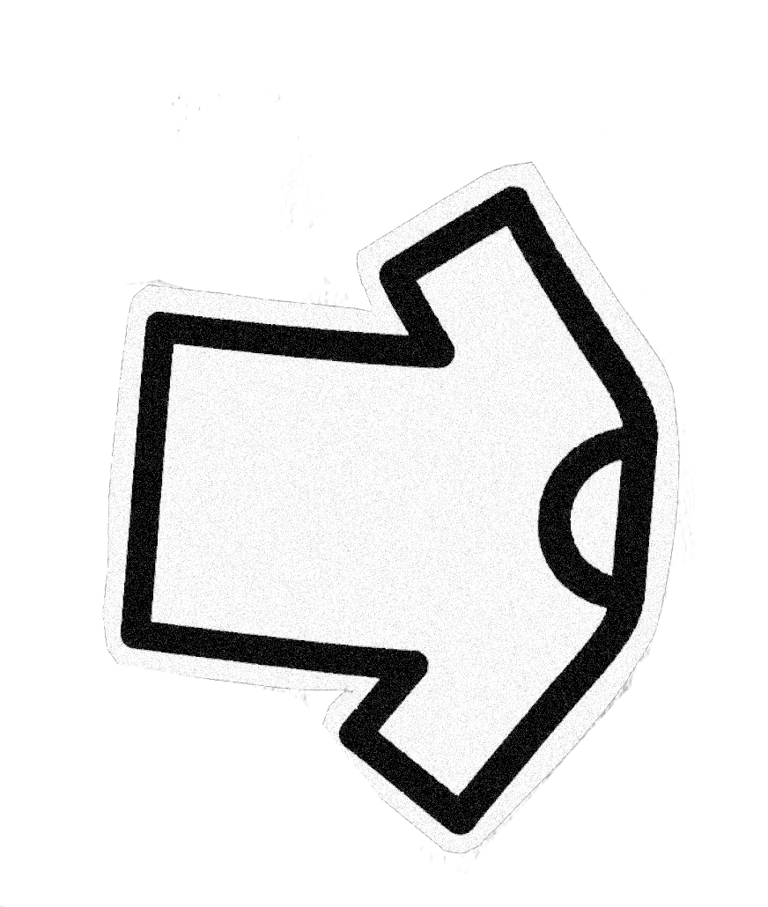
WHY WE ASK:
#WHOMADEMYCLOTHES?
Notes:
Many brands use a complicated network of suppliers to make their clothes. Instead of the brand employing makers, they pay money to factories who employ makers, which means the brands aren’t responsible for the health and safety of the workers.
When we ask brands, “Who Made My Clothes?”, it makes them publish the information of the suppliers they give money to, and this helps organisations like Fashion Revolution to monitor the wages, safety, and all human rights issues of the factories that makes clothes for big brands.

Slide 11
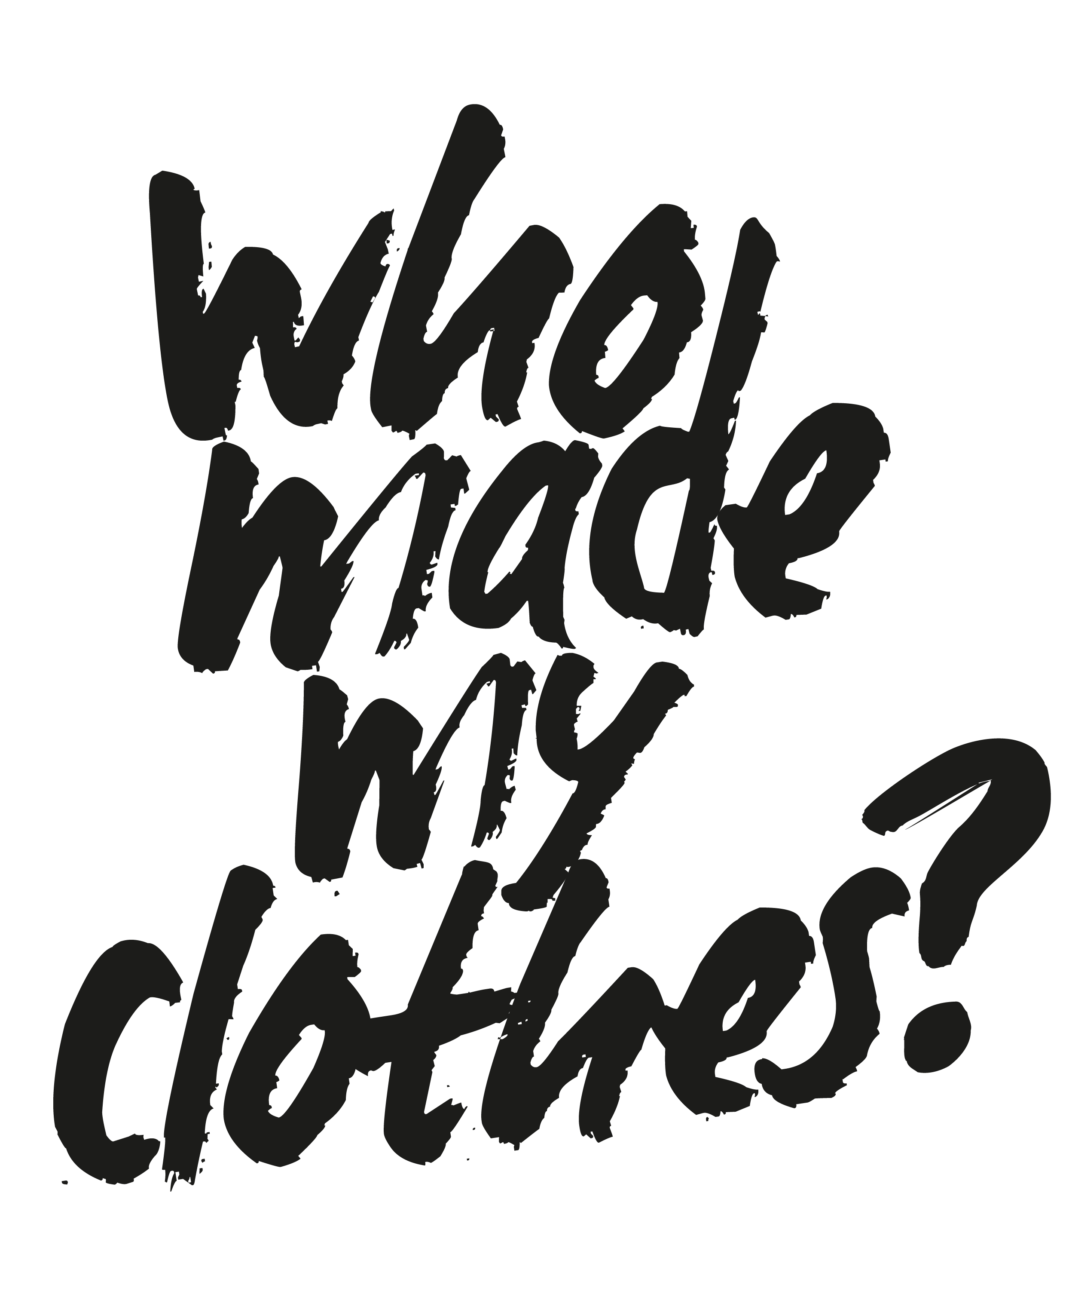
Notes:
Since Fashion Revolution started, people from all over the world have used their voice and their power to demand change from the fashion industry. And it’s working. The industry is starting to listen. We’ve seen brands being open about where their clothes are made and the impact their materials are having on the environment.
We’ve seen manufacturers make their factories safer and more of the people in the supply chain being seen and heard. Designers are now considering people and planet when creating new clothing. Citizens are thinking before they buy.
But the story is far from over. We are only just getting started. We can’t stop until every worker who makes our clothes is seen, heard and paid properly and the environments they live and work in are safe. We can't stop until the culture of consumption is changed and we learn to love and appreciate our clothes and the people that made them.

Slide 12
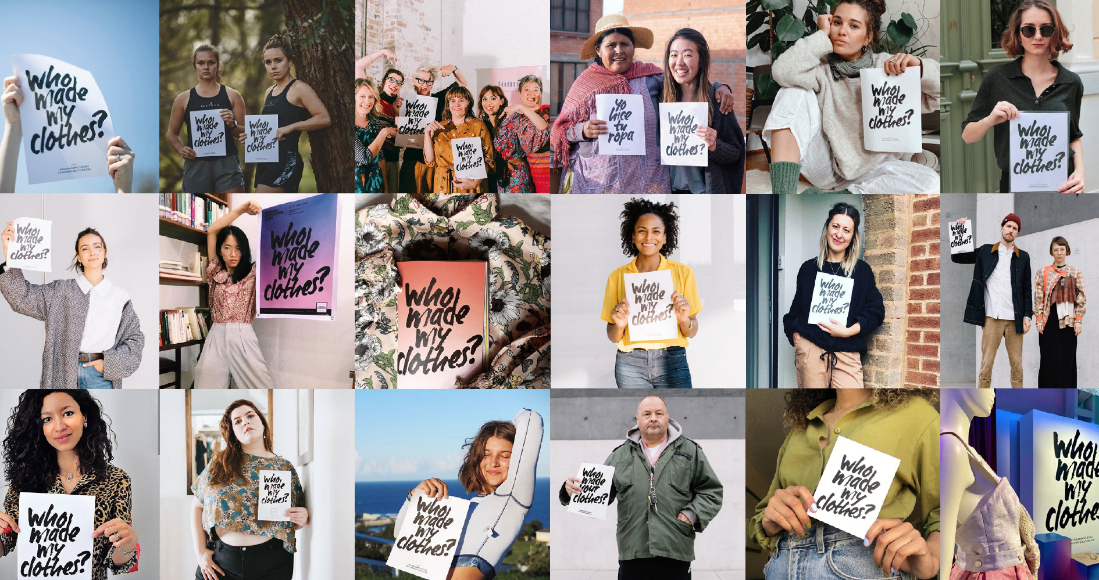
Notes:
In 2019, more than 55,000 people asked, “Who Made My Clothes?”

Slide 13
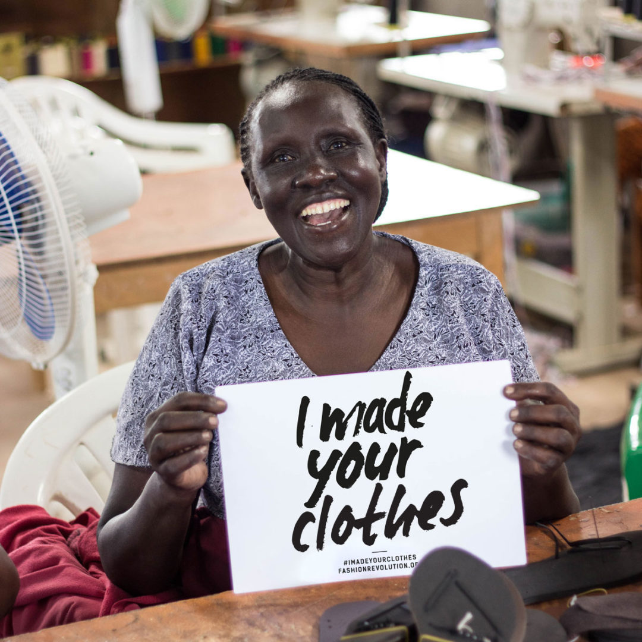
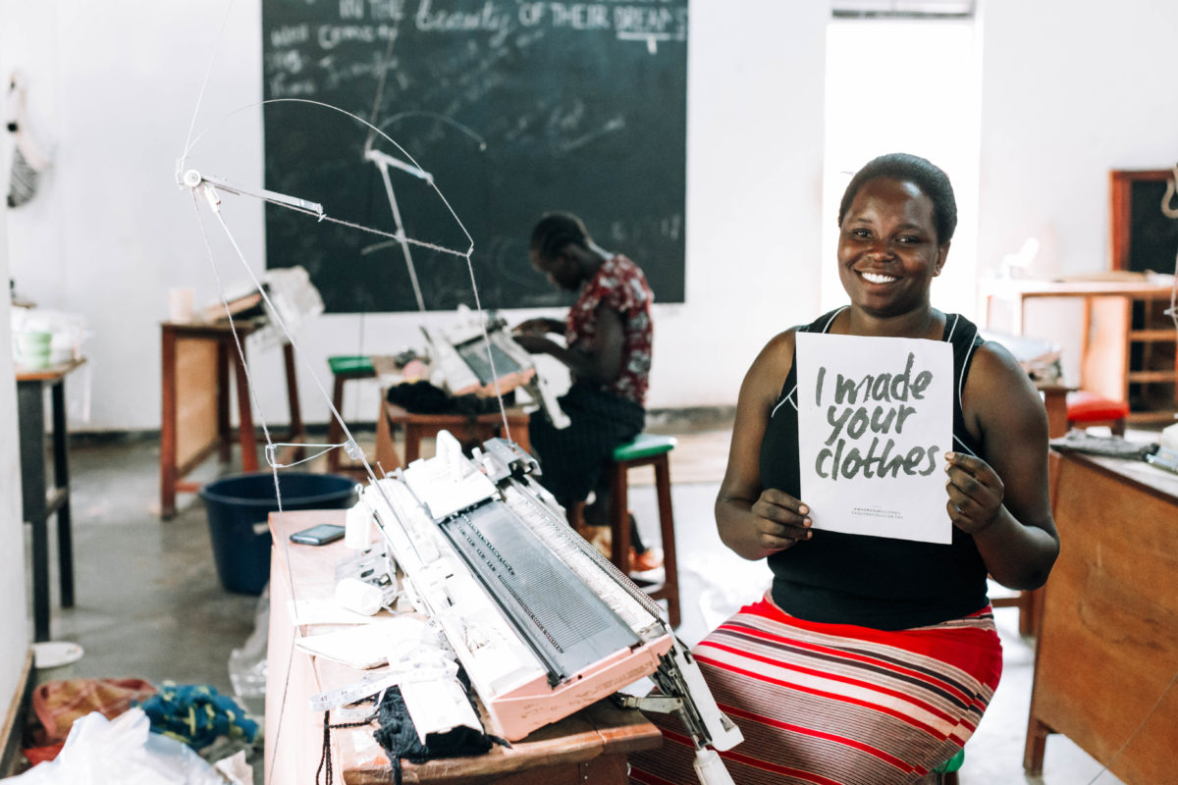
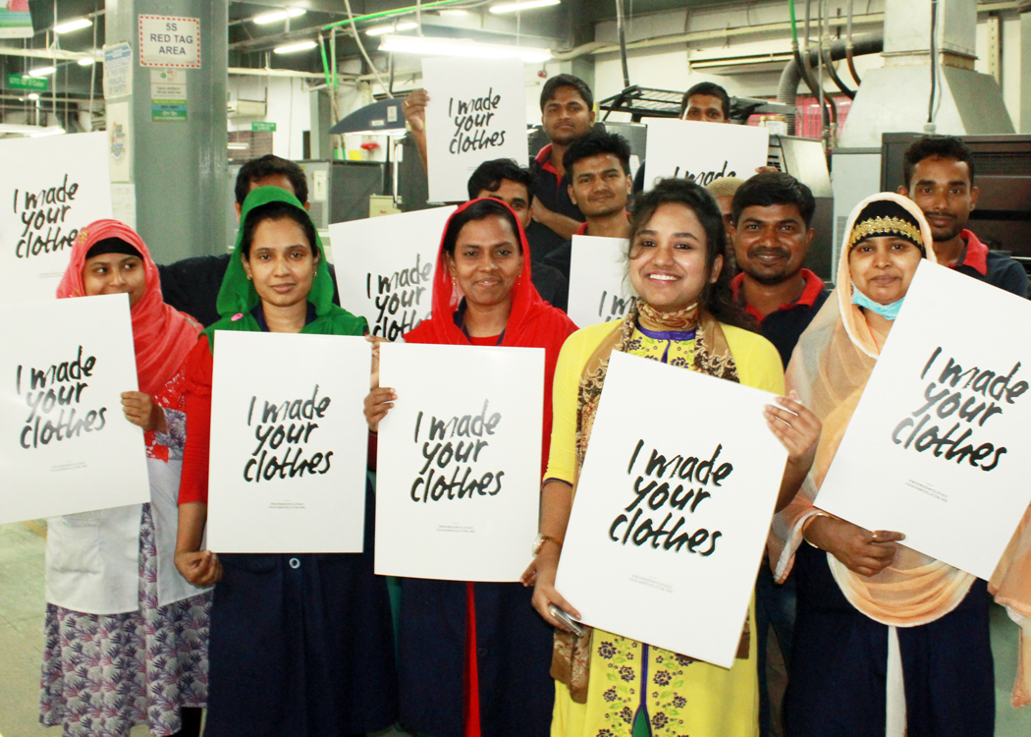
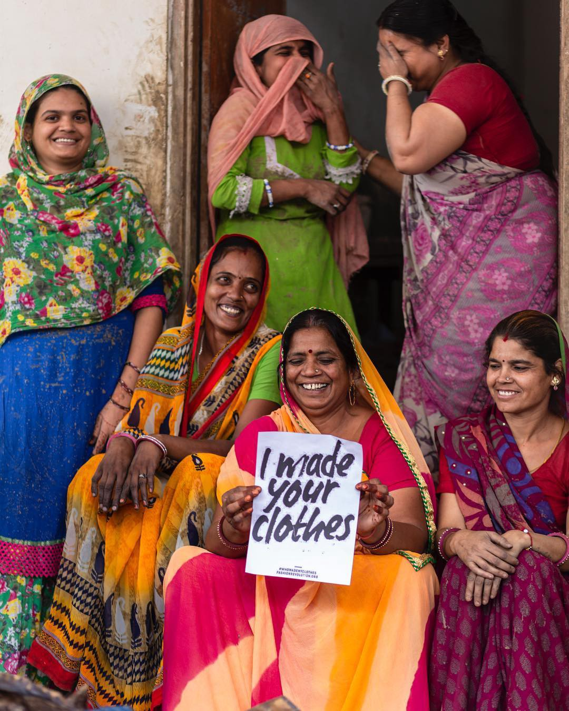
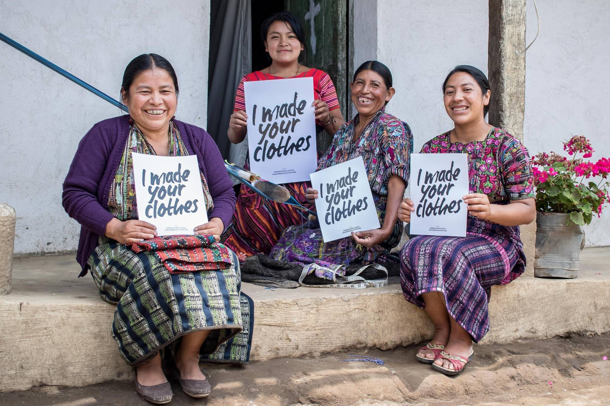
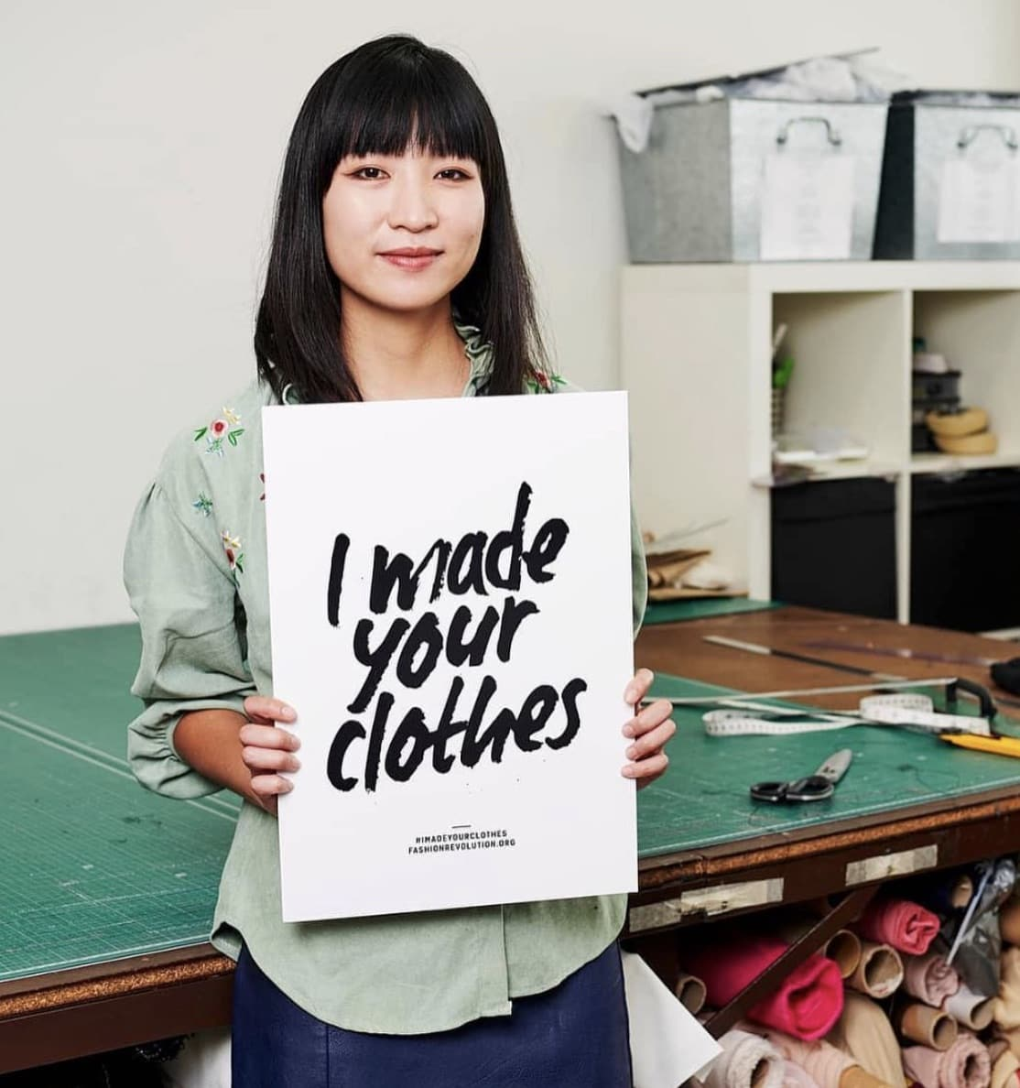
WHEN WE ASK
#WHOMADEMYCLOTHES?
BRANDS RESPOND
Notes:
When we ask ‘Who Made My Clothes’, brands respond, and it makes the fashion industry better by giving a voice to the people who make our clothes.
During Fashion Revolution Week 2019 more than 12,000 brands, garment workers, retailers and makers responded to the question #whomadeclothes.

Slide 14

WHY WE ASK:
#WHATSINMYCLOTHES?
Notes:
Many of the clothes we wear are made from fabrics and other materials that hurt the environment.
Most clothing is either polyester, cotton, viscose, or nylon. These fibres can have negative impacts. For example, polyester and nylon are made from plastic, which means that they don’t decompose once they are discarded. Cotton often used pesticides, which pollute waterways where the crop is grown. And viscose is usually made from trees which means it can destroy the habitats of forest animals.
As materials are created, harmful substances are often added, like dangerous dyes and toxic chemicals.
This year, Fashion Revolution has introduced the question “What’s in my Clothes” to ask brands to create materials in a more sustainable way.

Slide 15
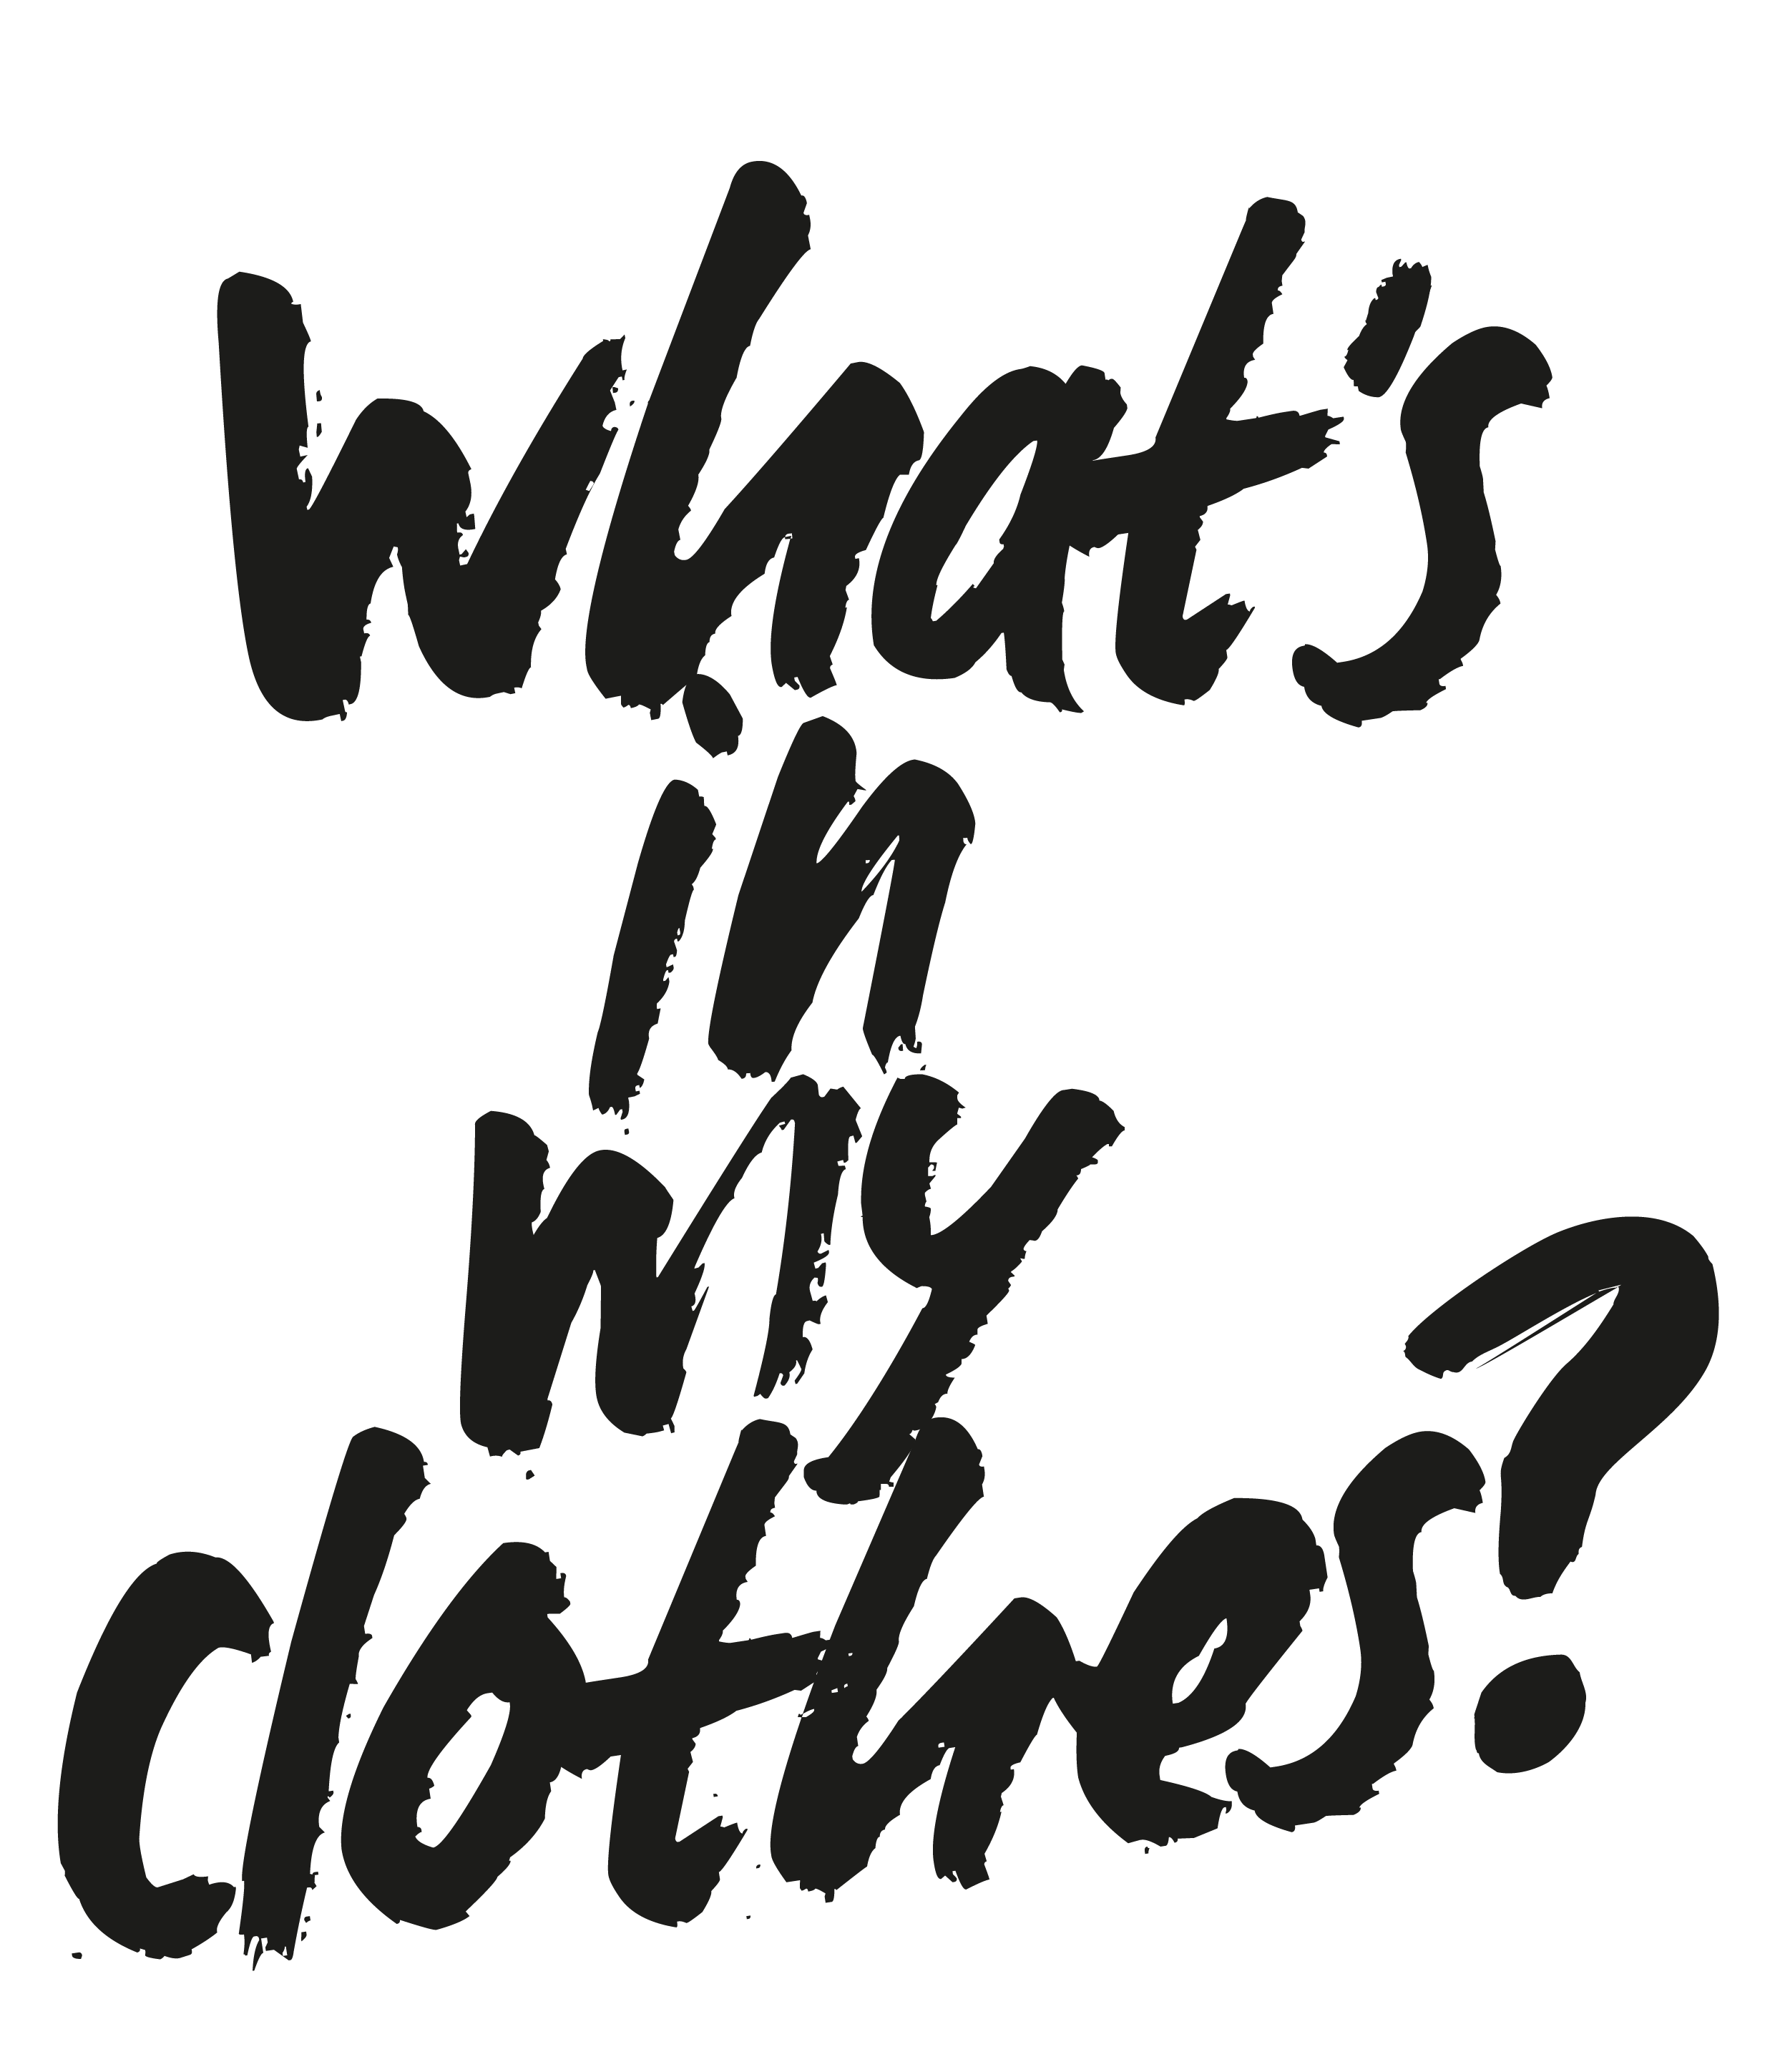
Notes:
Asking “What’s in my clothes” is a new activation for us at Fashion Revolution.
Some ways that students can take part are:
Sending a postcard to their policy maker + emailing a brand. Both of these resources can be found on our website here: https://www.fashionrevolution.org/resources/free-downloads/

Slide 16
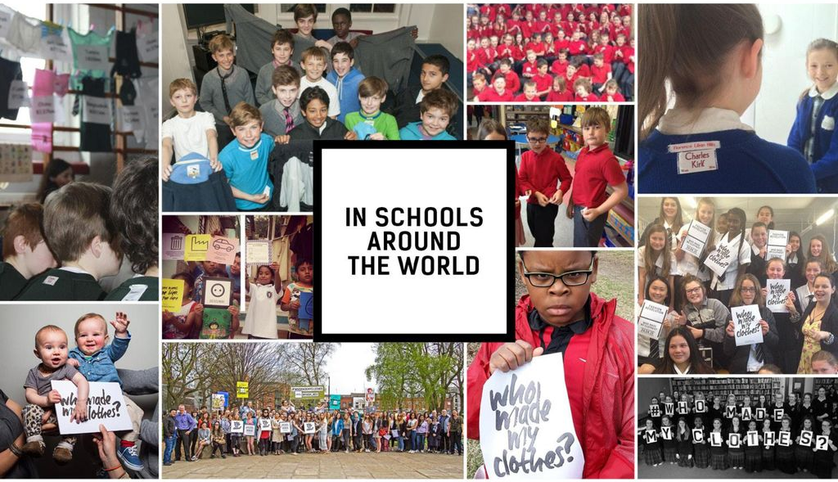
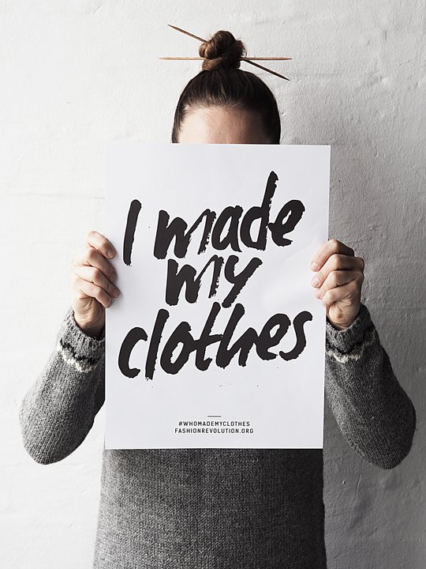
Notes:
Fashion Revolution Week is celebrated in schools and universities across the world from,primary school children right up to university level. They share their activities on social media using the hashtag #whomademyclothes. (According to the policies of each individual establishment).

Slide 17
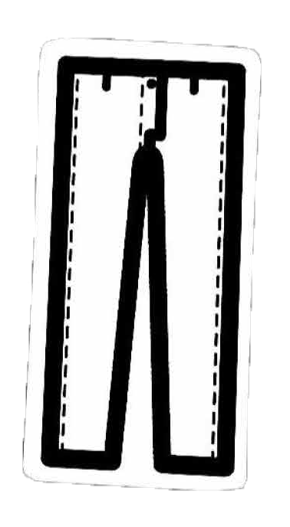
LET’S USE OUR CREATIVITY TO MAKE FASHION BETTER FOR EVERYONE!
www.fashionrevolution.org
Notes:
Learn more at www.fashionrevolution.org

