Slide 1

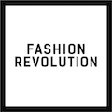
FASHION
REVOLUTION
WEEK
20-26 April 2020
-
Use your voice.
Ask brands
#WhoMadeMyClothes?
www.fashionrevolution.org
Notes:
Fashion Revolution is a movement which wants to make the clothing industry fairer for everyone involved.
This Powerpoint is an introduction to Fashion Revolution and its key messages for you to use in the classroom and is useful as a starting point for any other Fashion Revolution educational resources. We have provided accompanying notes but feel free to adapt them to your own requirements.

Slide 2
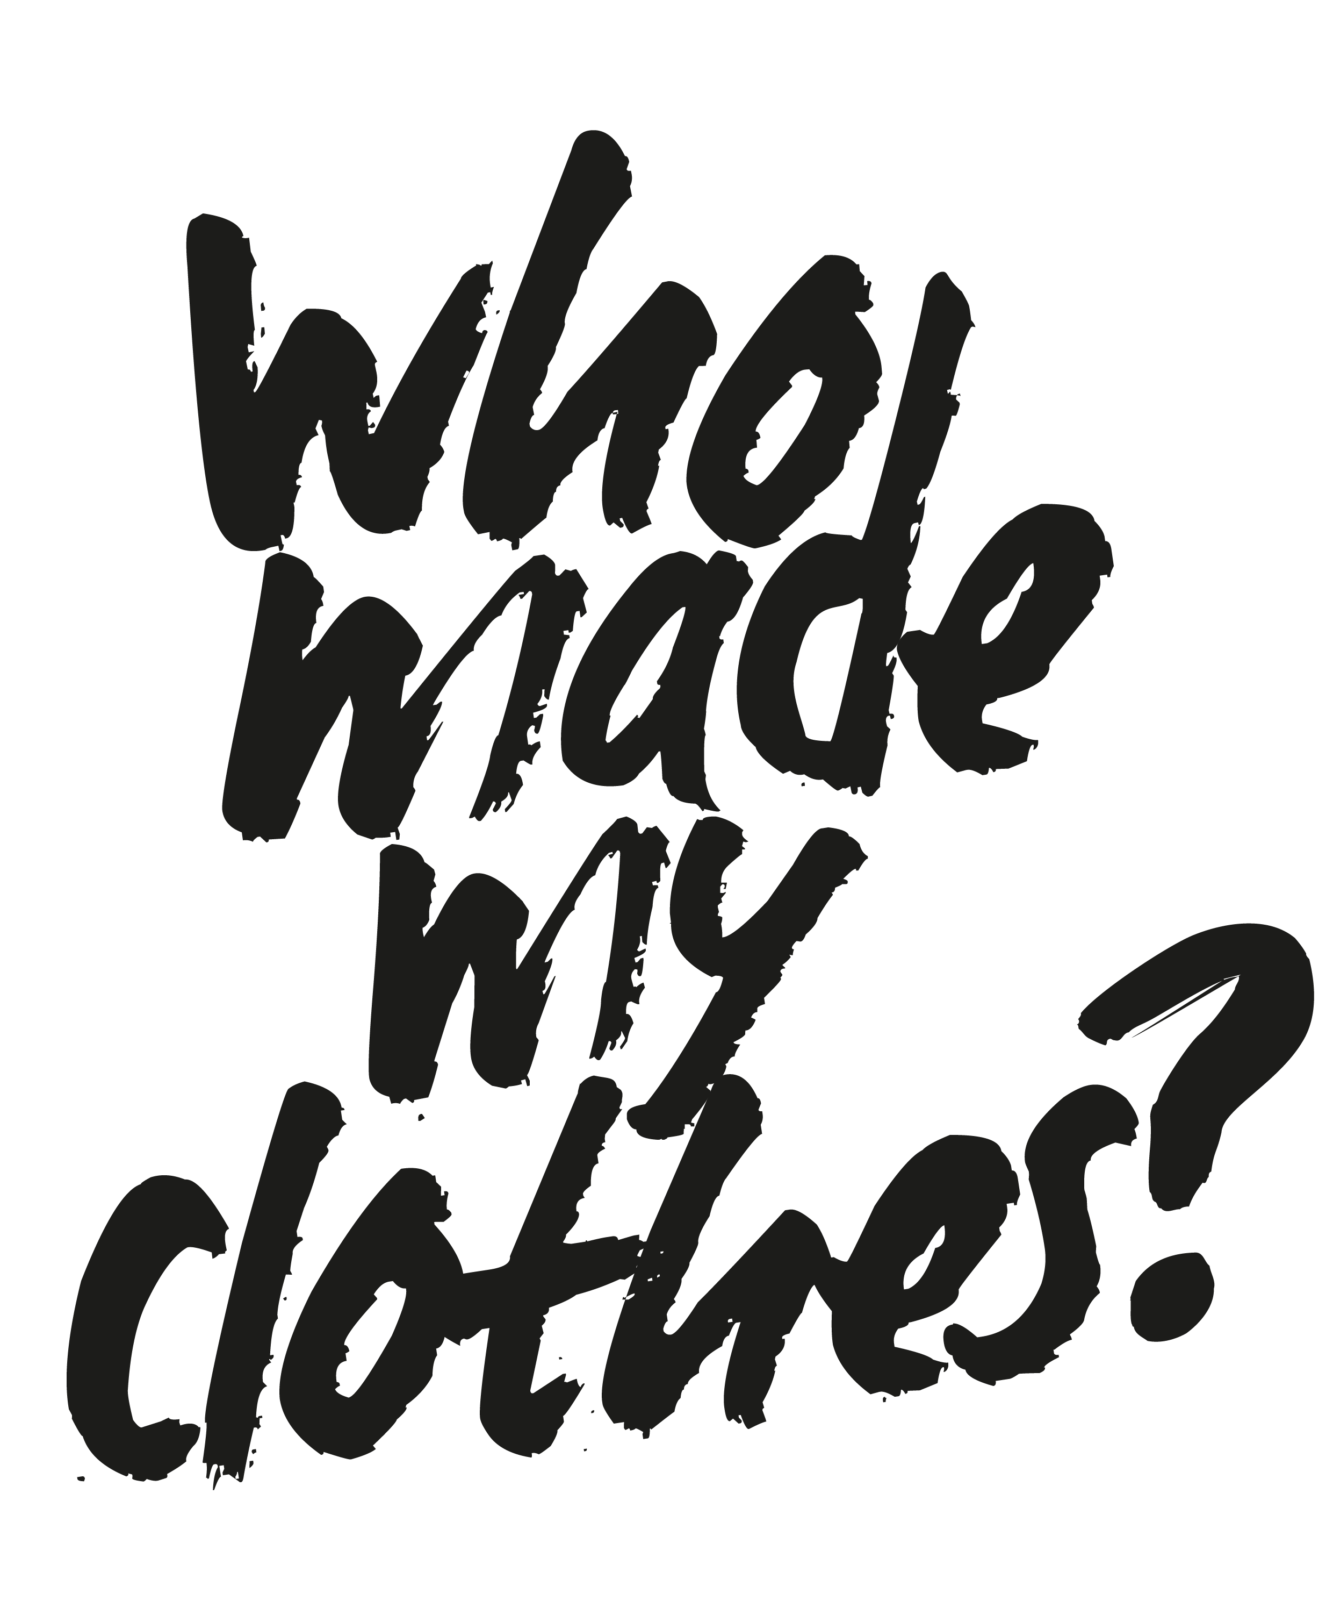
Notes:
The core theme is asking the question ‘who made my clothes’ and helping us all to understand more about the lives of the people who make our clothes.

Slide 3
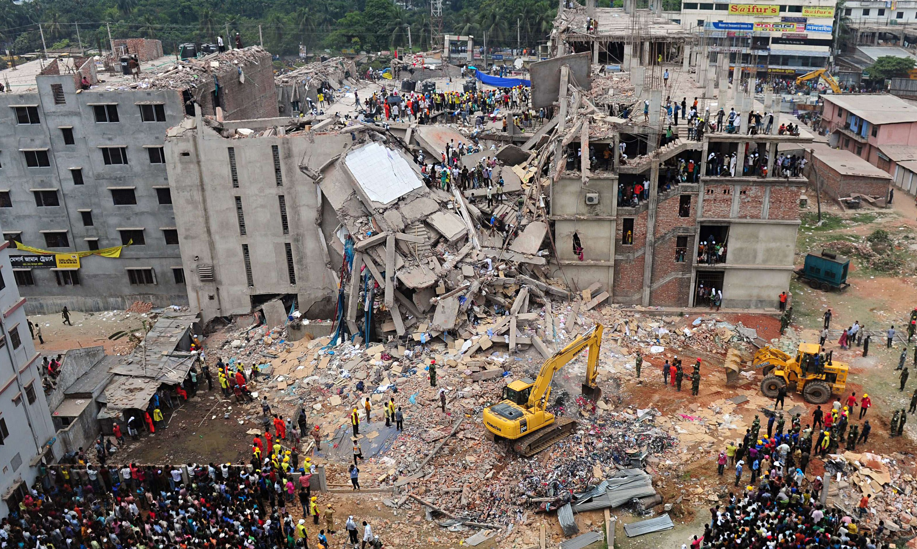
Notes:
On 24 April 2013 a garment factory in the Rana Plaza complex in Bangladesh collapsed. There were five garment factories in Rana Plaza all manufacturing clothing for the western market. The victims were mostly young women.

Slide 4
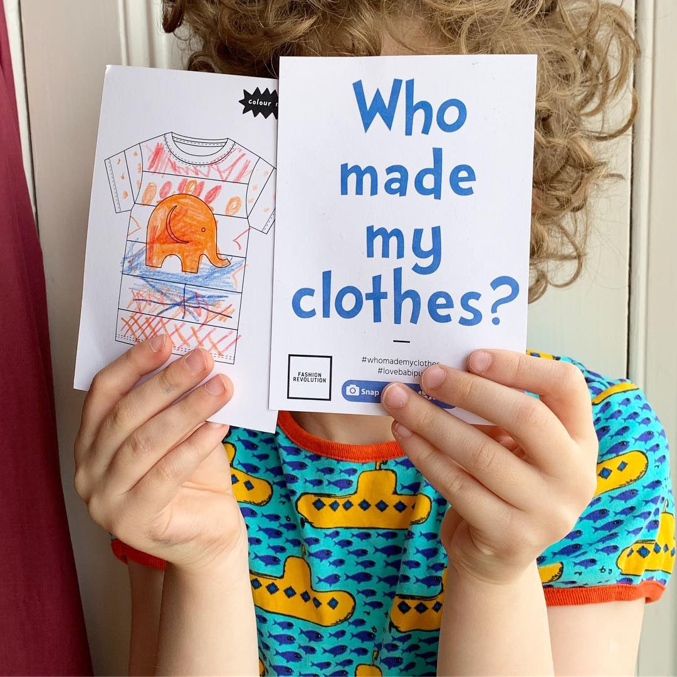
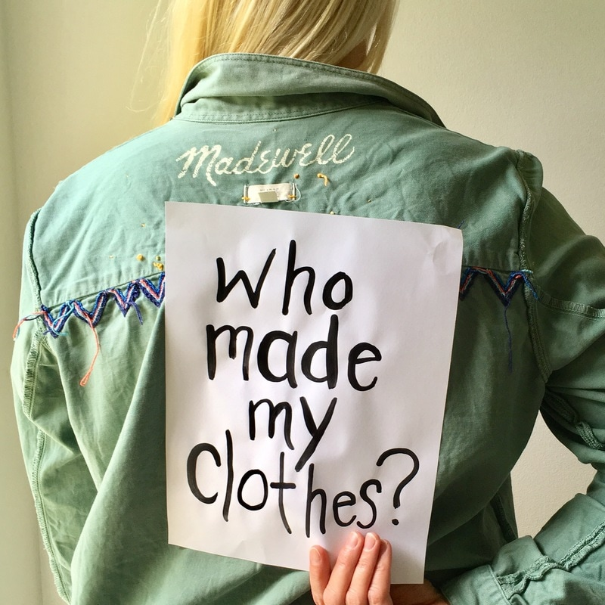
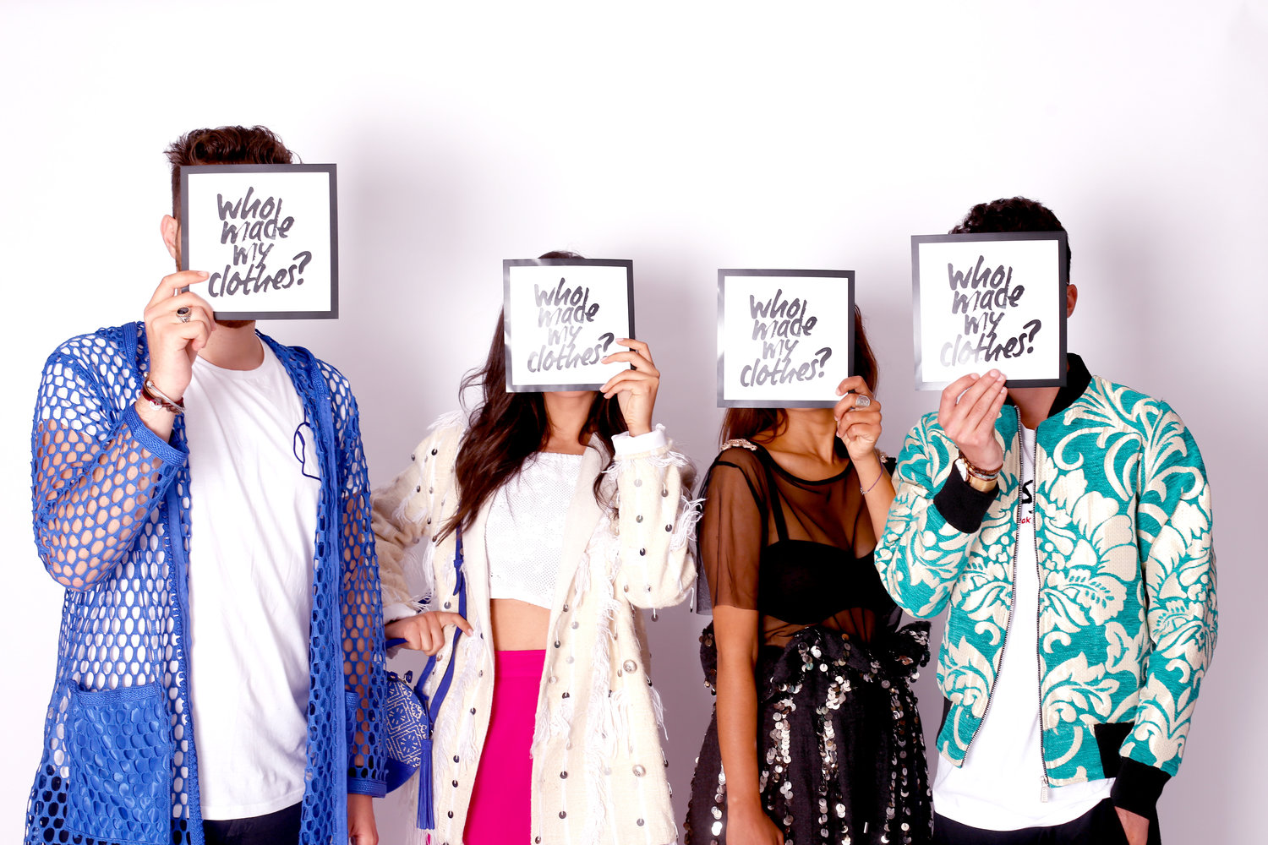
Notes:
Since then people from all over the world have come together to use the power of fashion to change the world. Fashion Revolution is now a global movement of people like you.

Slide 5
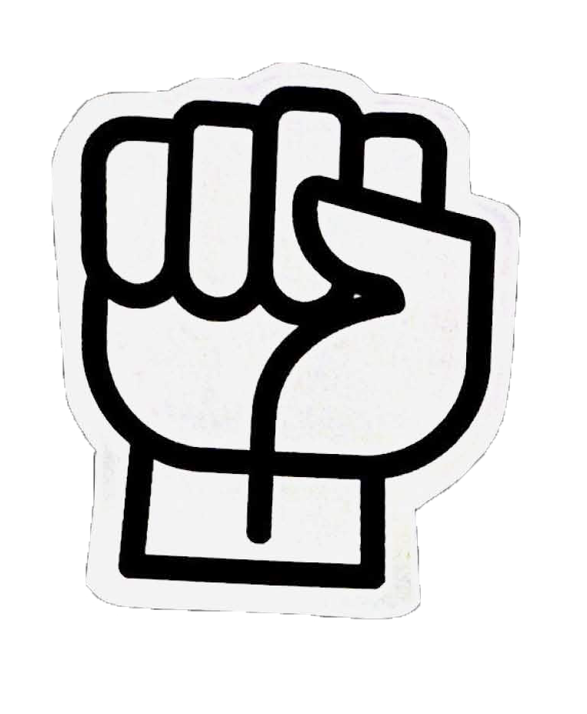
WE ARE FASHION REVOLUTION
We believe in a global fashion industry that conserves and restores the environment and values people over growth and profit.
Notes:
Fashion Revolution is a global movement that wants to change the way the fashion industry works.
It invites designers, academics, writers, business leaders, policymakers, brands, retailers, marketers, producers, makers, workers and fashion lovers to be involved.
Fashion Revolution believes that positive change can happen if we all think differently about fashion and demand better. It campaigns for a cleaner, safer, fairer, more transparent and more accountable fashion and textiles industry.
It wants fashion to become a force for good – an industry that values people and planet over profit and growth.

Slide 6
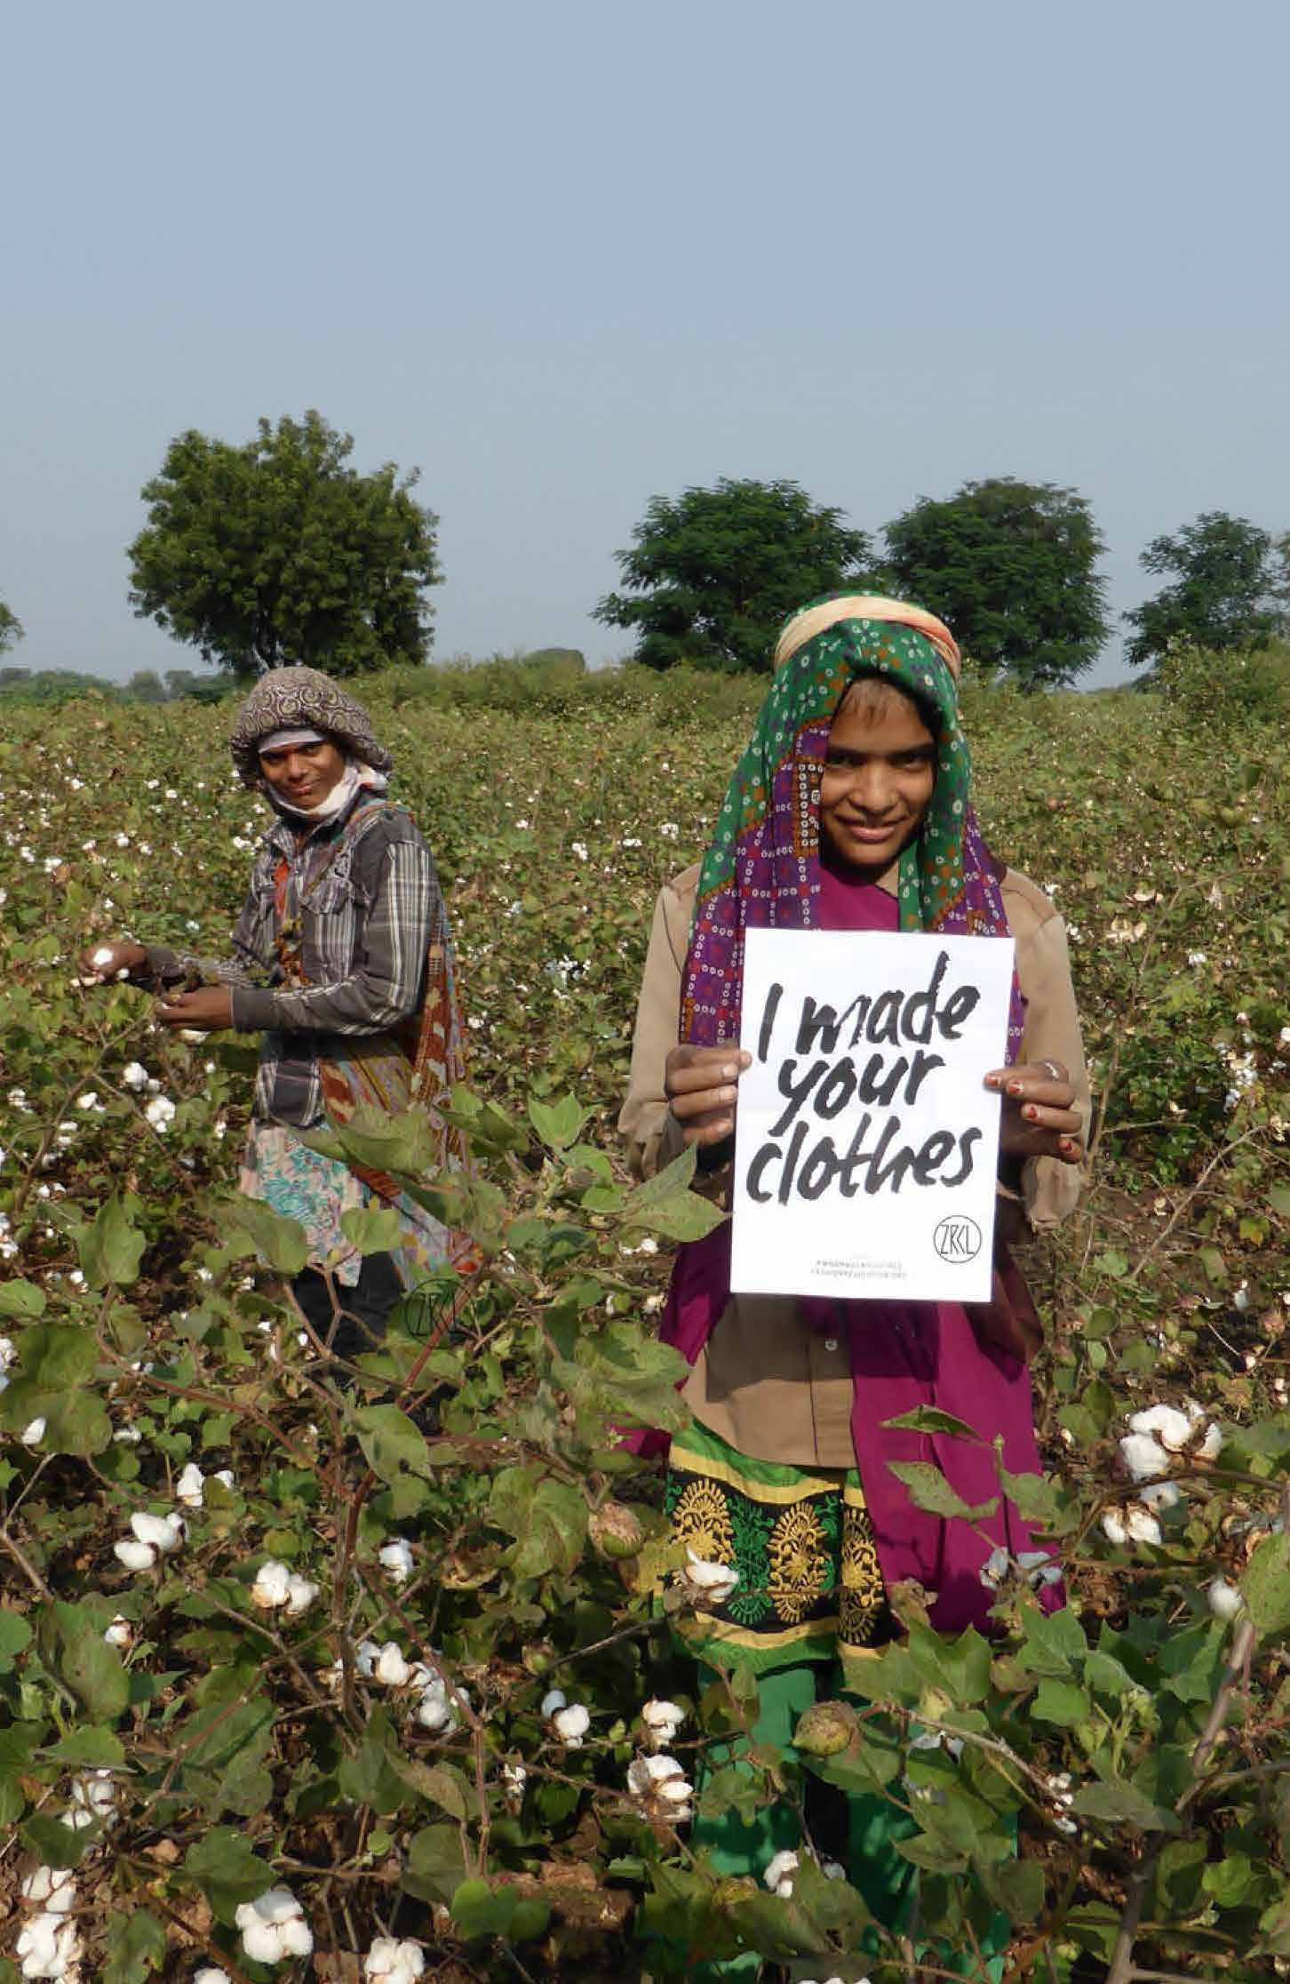
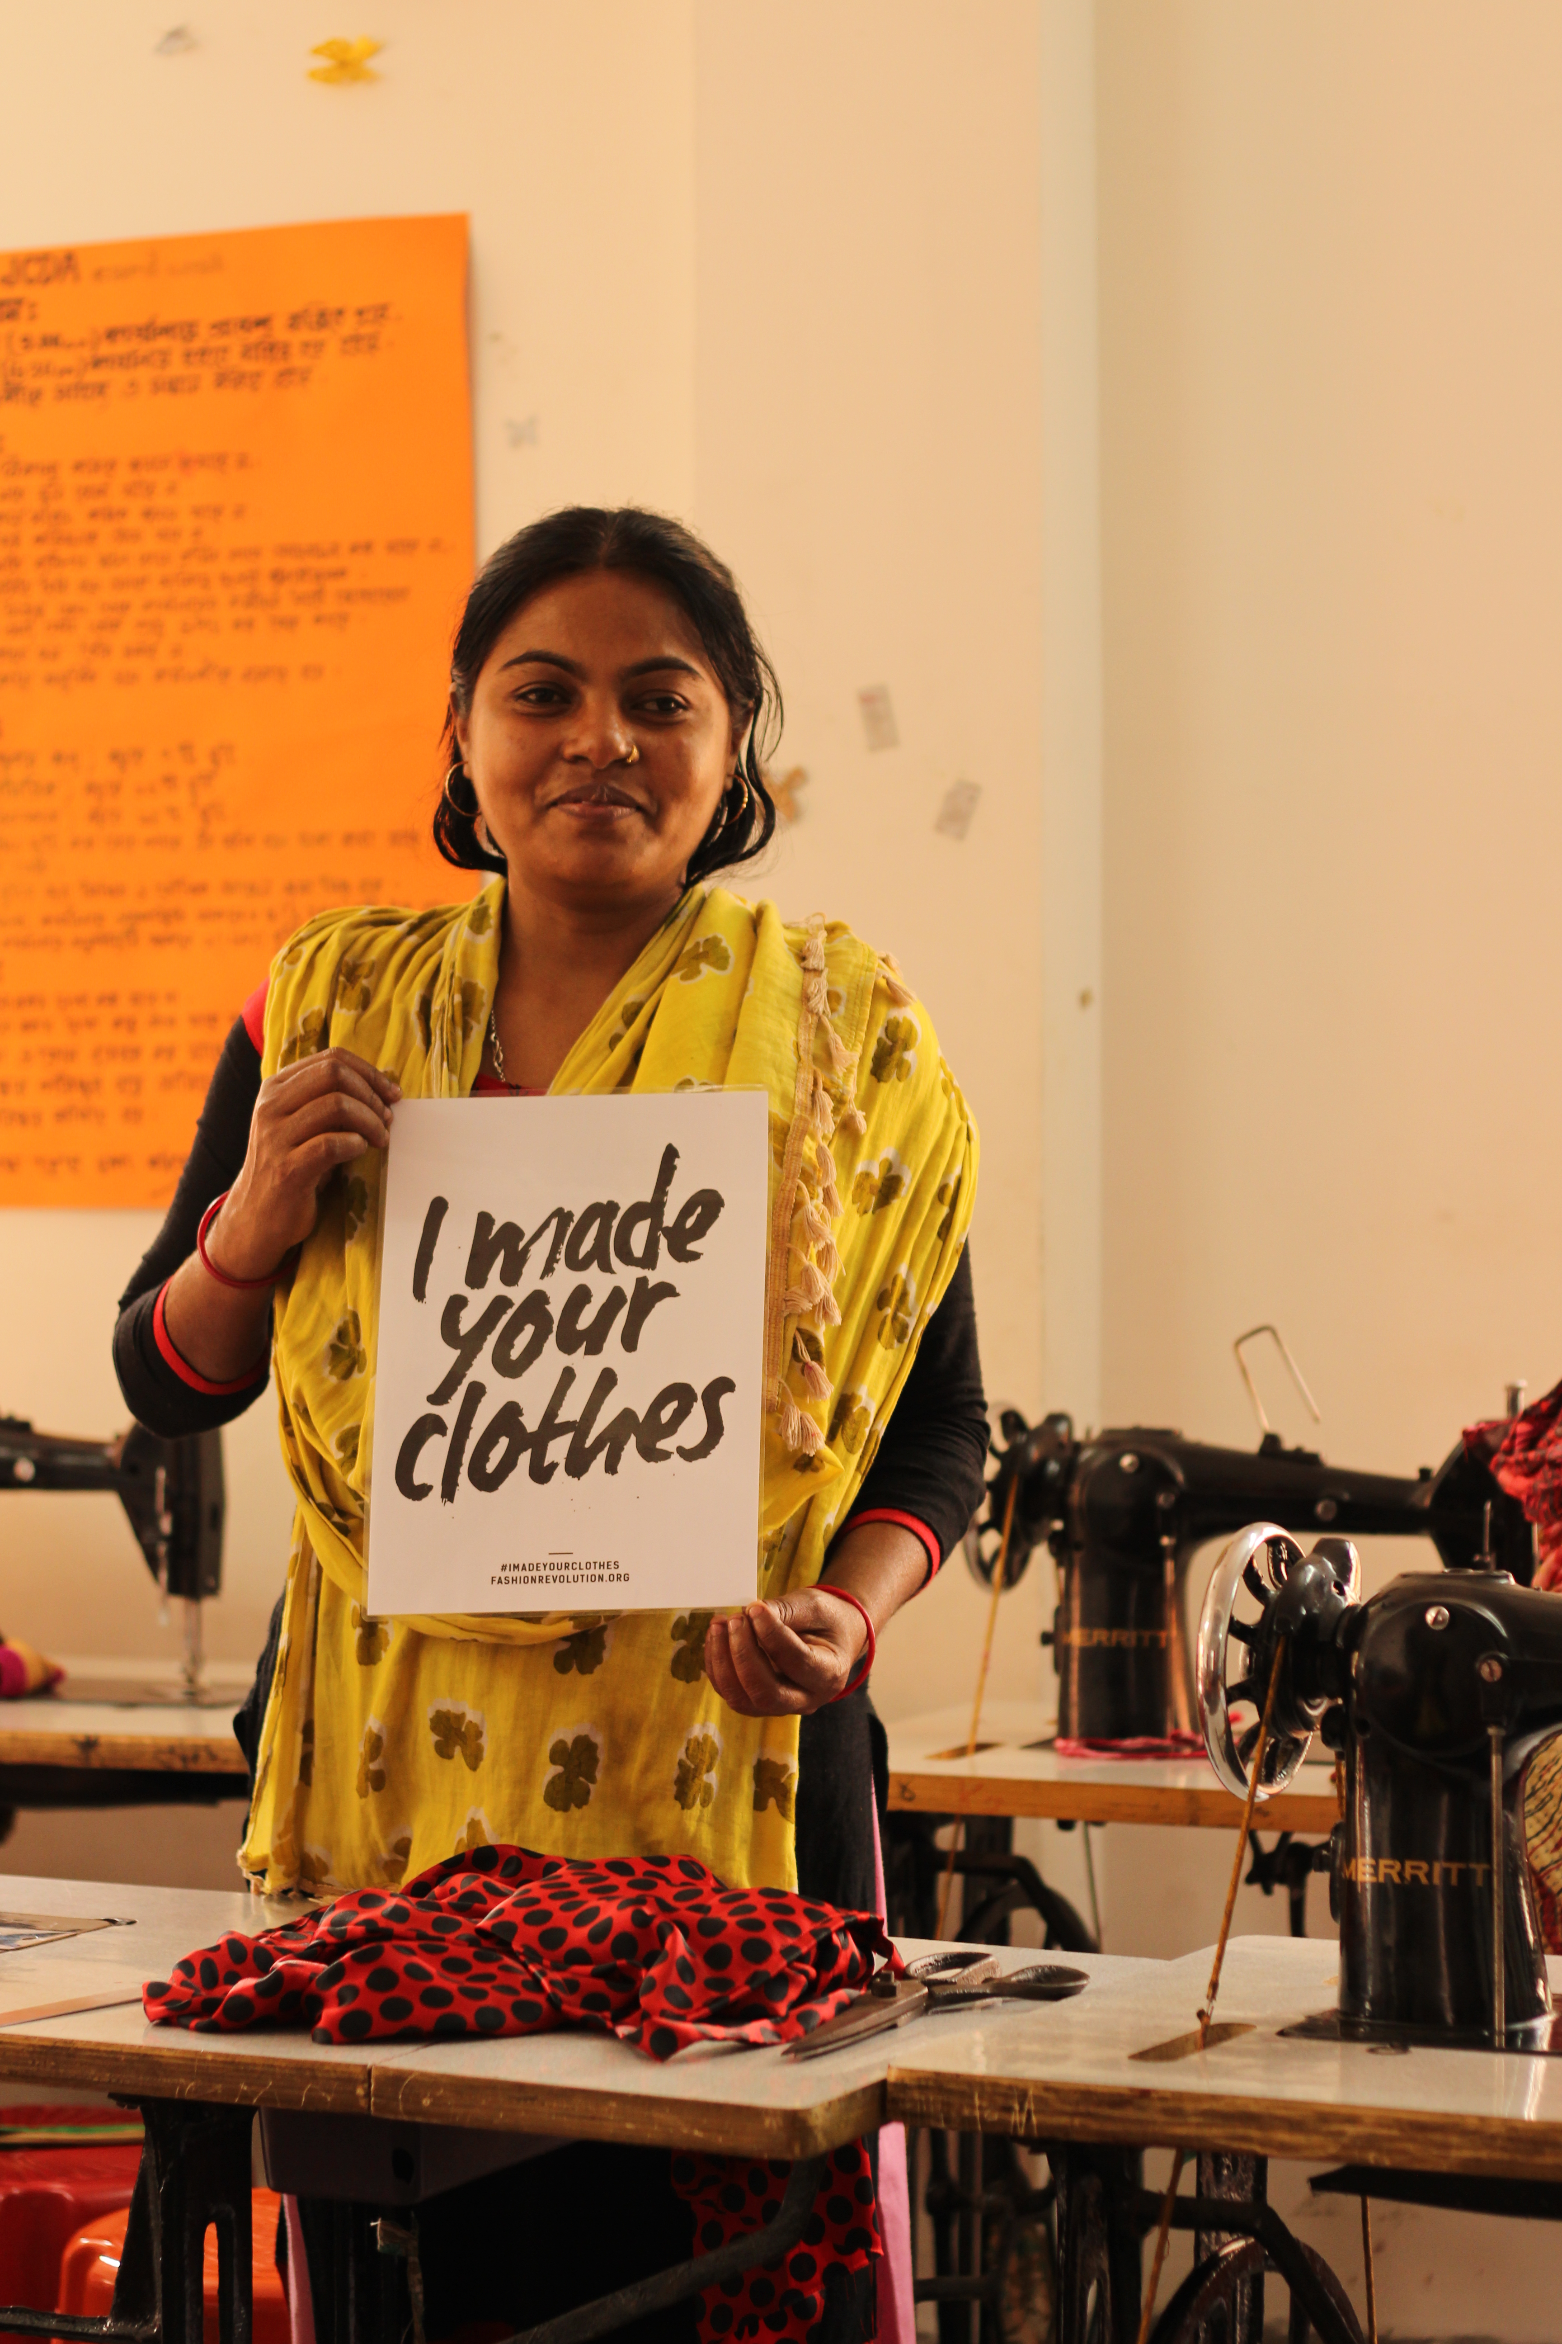
FROM
FARM TO FACTORY
TO SHOP
Notes:
Millions of people work in the fashion industry. We believe the industry can and should work better for all of them.

Slide 7
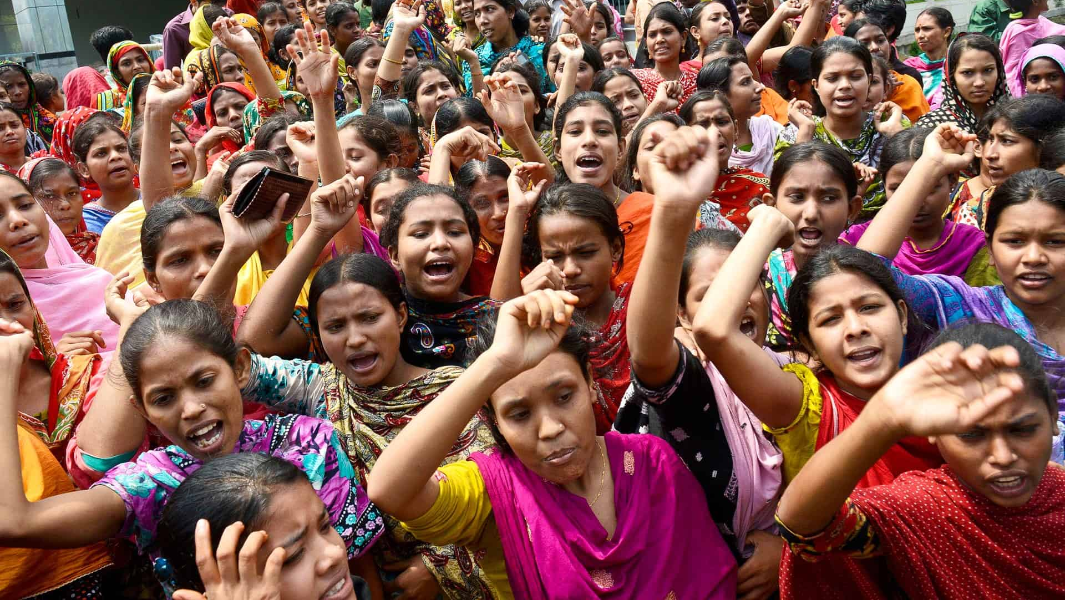
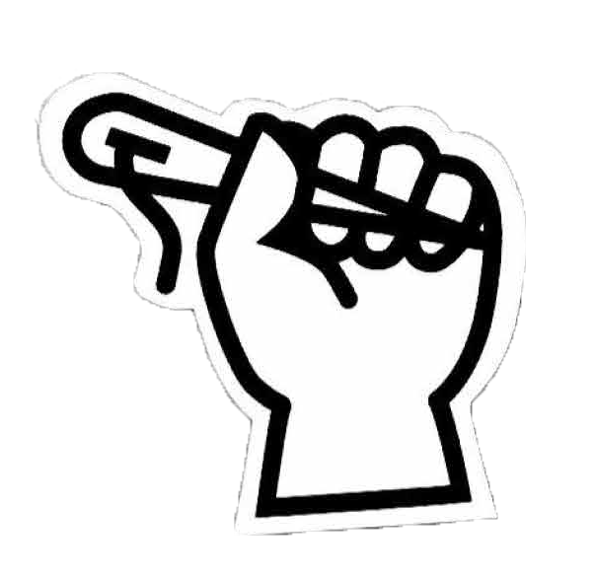
WHY DO WE NEED
A FASHION
REVOLUTION?
The fashion industry is broken. The people who make are clothes are often treated badly, which might mean they don’t earn enough money to live on, or they work in buildings that aren’t safe. Sometimes it means that the people who make our clothes are bullied.
Notes:
The fashion industry is broken. Human rights abuses and environmental degradation are endemic. What if your clothes are made in an exploitative way; how are you to know?
A lot of brands don’t know who makes their clothes, so how are we supposed to make informed purchases? This needs to change. We need to know who makes our clothes and under what conditions. We need to be able to scrutinise what it is we’re paying for.

Slide 8
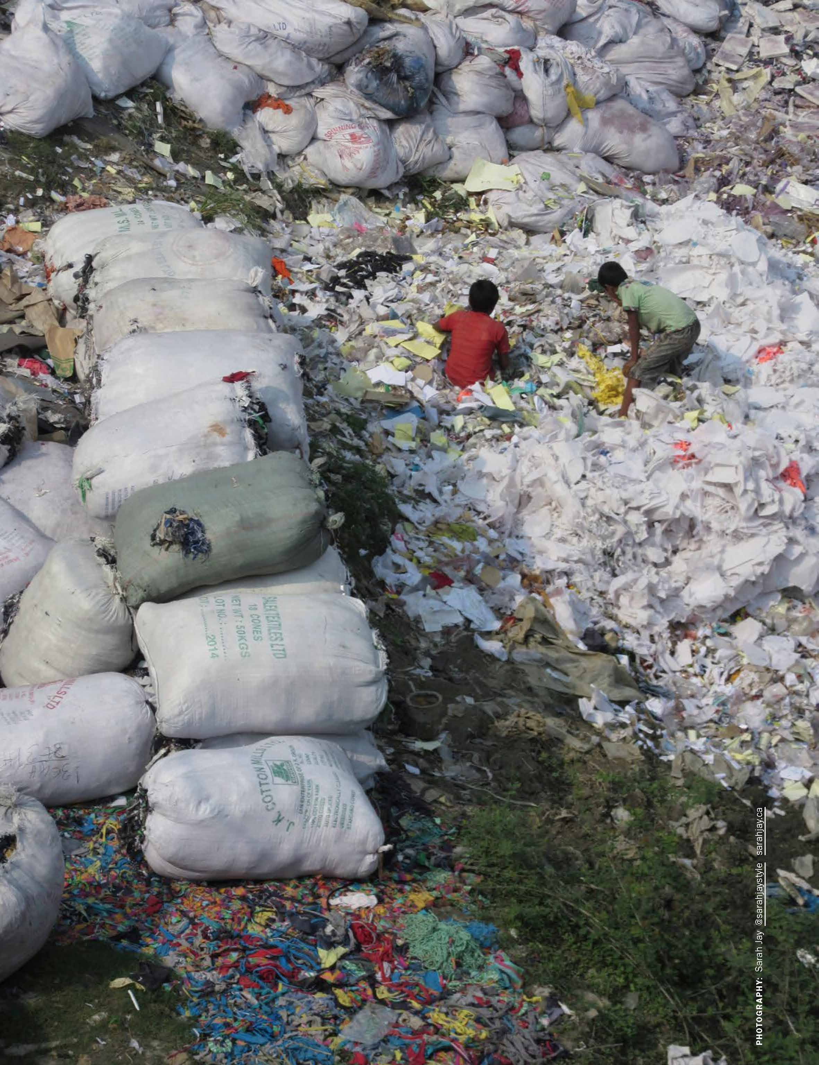

WHY DO WE NEED
A FASHION
REVOLUTION?
The way many clothes are made is harmful to the planet, using too many natural resources and polluting land and air. And because we buy more clothing than we need, too many waterways, forests, and farmlands become damaged.
Notes:
The environmental impact of our clothes can be reduced by: buying fewer clothes, washing our clothes less, and looking for fibres like organic cotton, and recycled fibres. Just like bottles and packaging, some of the clothes we wear can be recycled into new products.

Slide 9
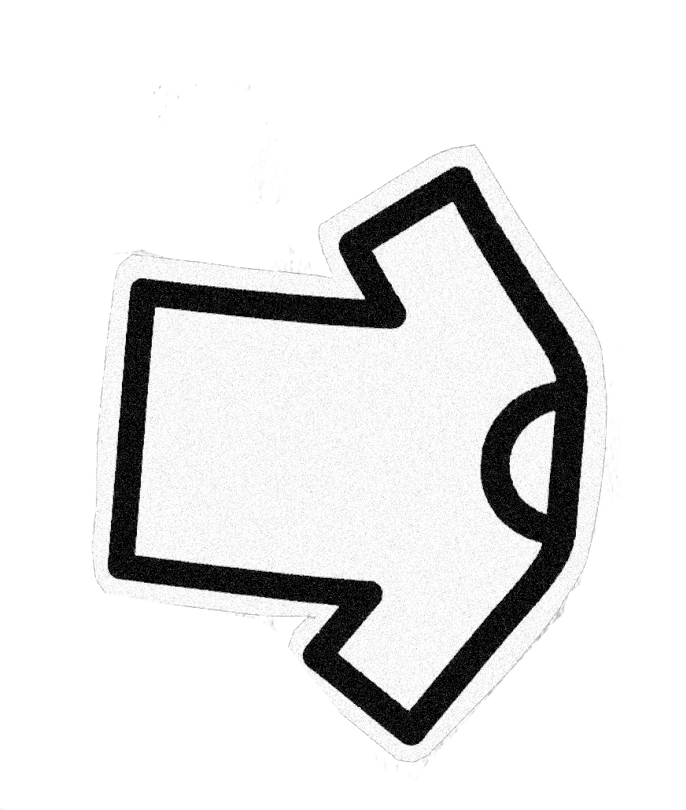
WHY WE ASK:
#WHOMADEMYCLOTHES?
Notes:
Many brands use a complicated network of suppliers to make their clothes. Instead of the brand employing makers, they pay money to factories who employ makers, which means the brands aren’t responsible for the health and safety of the workers.
When we ask brands, “Who Made My Clothes?”, it makes them publish the information of the suppliers they give money to, and this helps organisations like Fashion Revolution to monitor the wages, safety, and all human rights issues of the factories that makes clothes for big brands.
Our “Who Made My Clothes?” posters can be downloaded here: https://drive.google.com/drive/u/1/folders/102J6SiM2XVluZuU7hM33C33OaaZ_LRK5

Slide 10
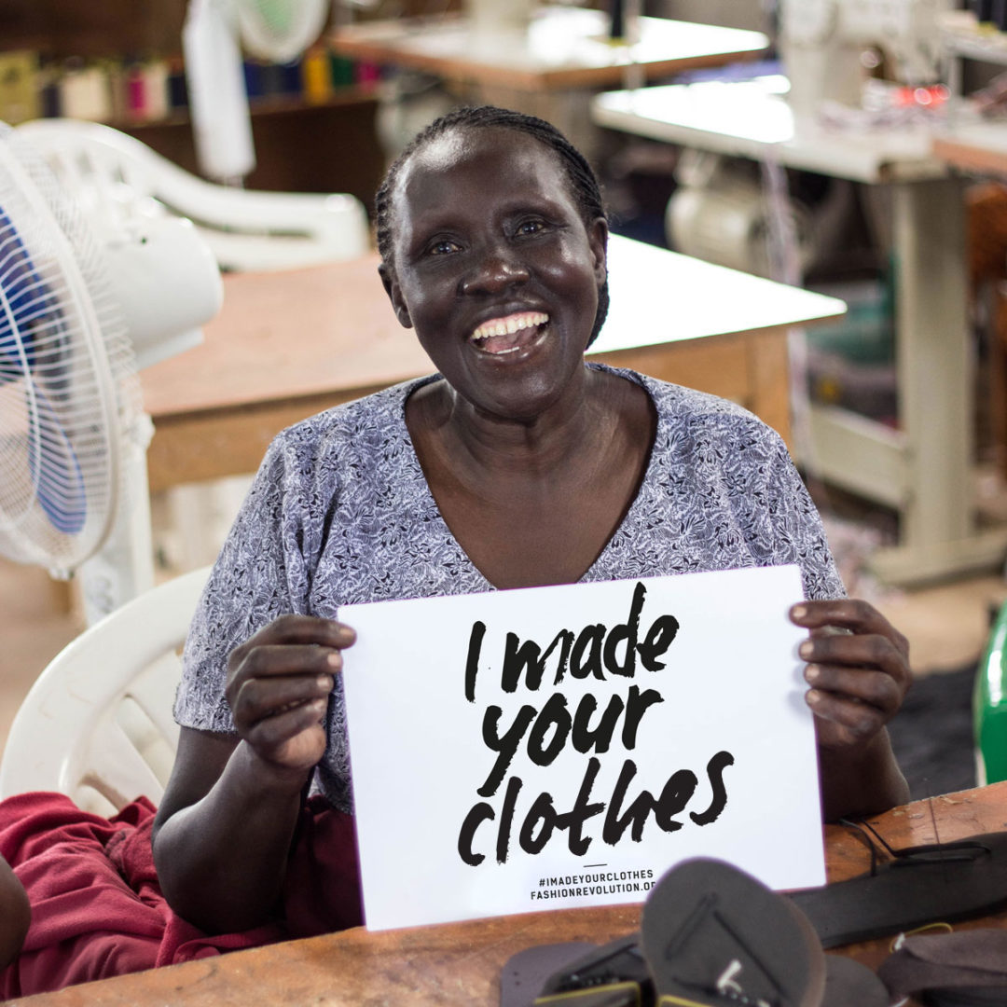
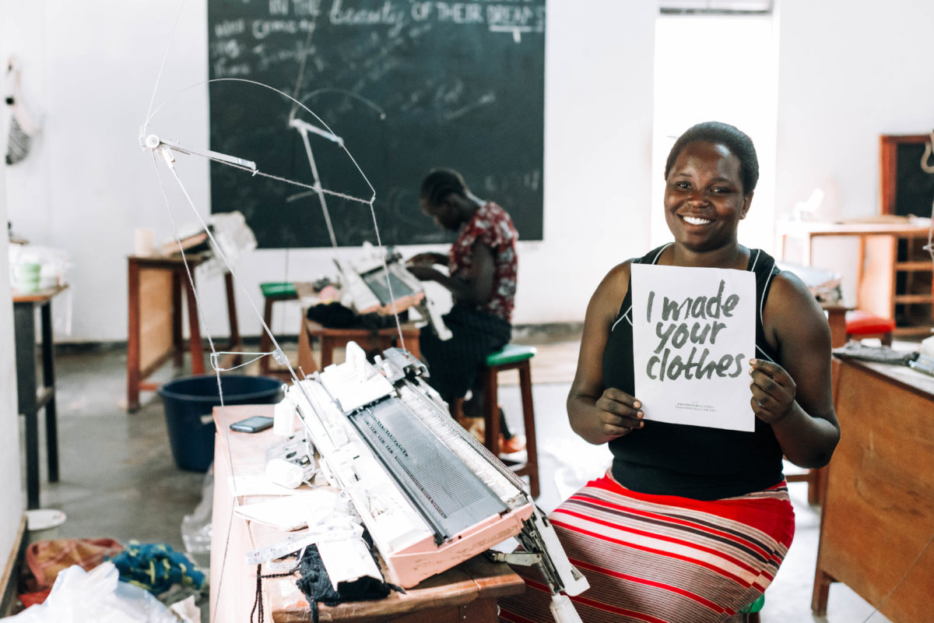
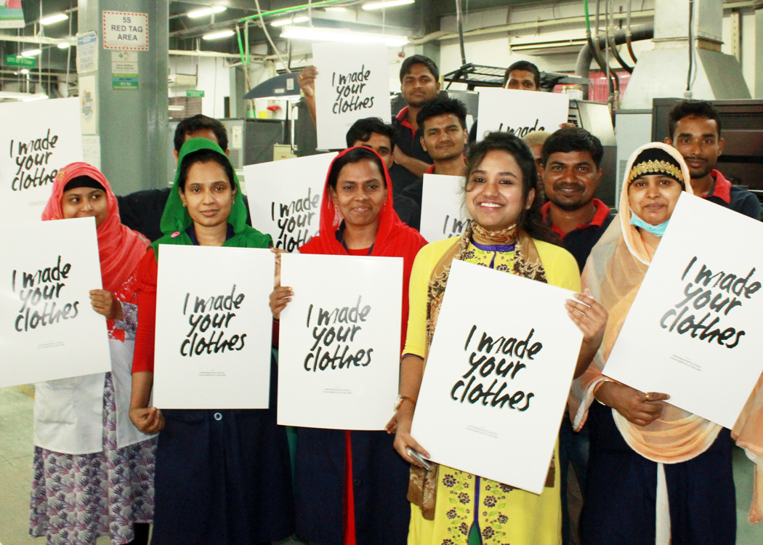
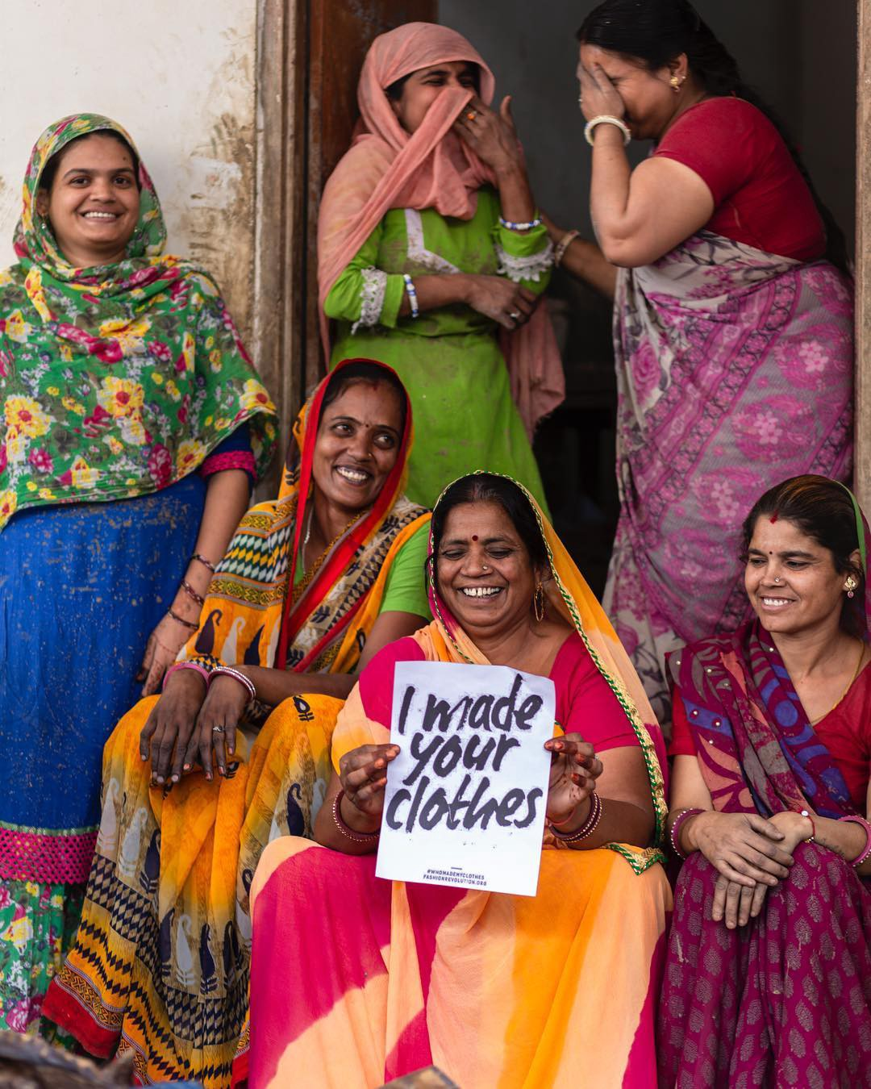
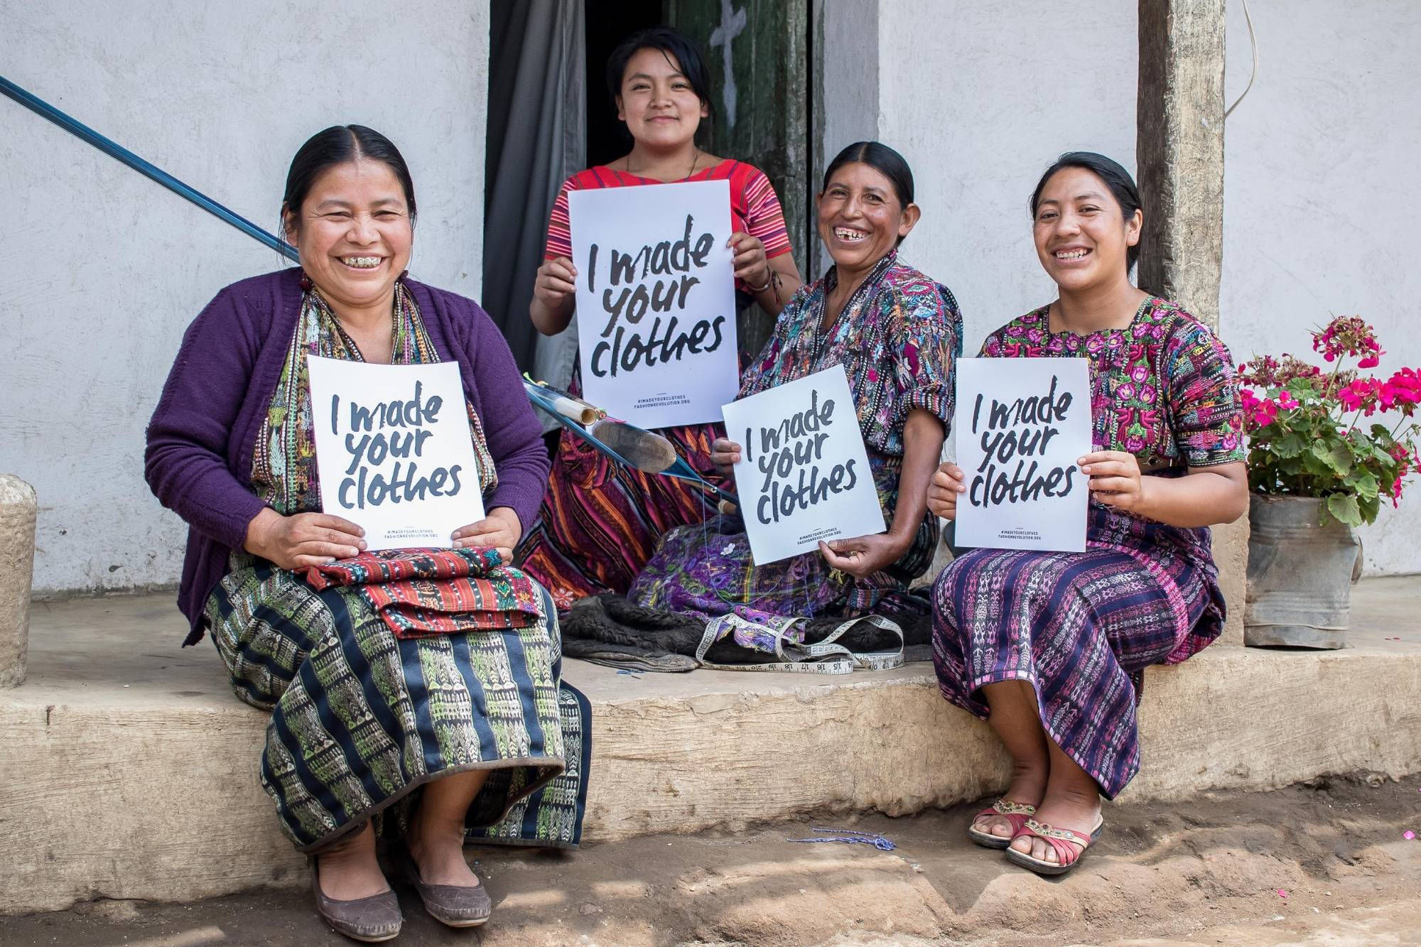
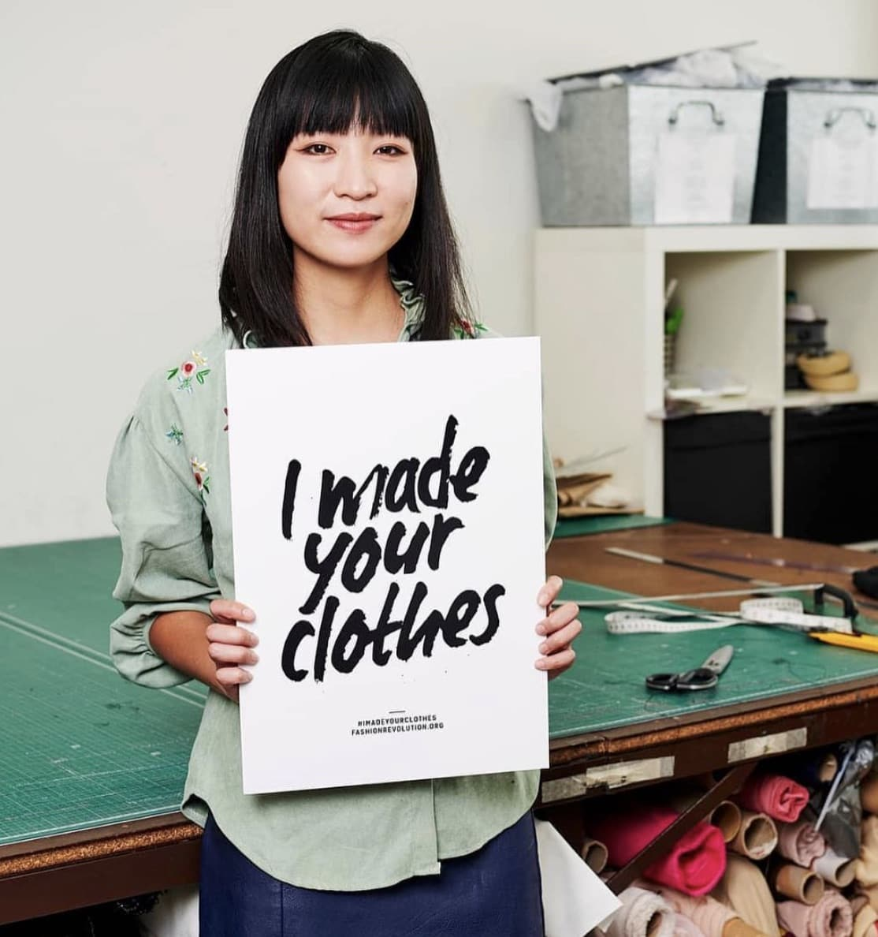
WHEN WE ASK
#WHOMADEMYCLOTHES?
BRANDS RESPOND
Notes:
When we ask ‘Who Made My Clothes’, brands respond, and it makes the fashion industry better by giving a voice to the people who make our clothes.
During Fashion Revolution Week 2019 more than 12,000 brands, garment workers, retailers and makers responded to the question #whomadeclothes.

Slide 11
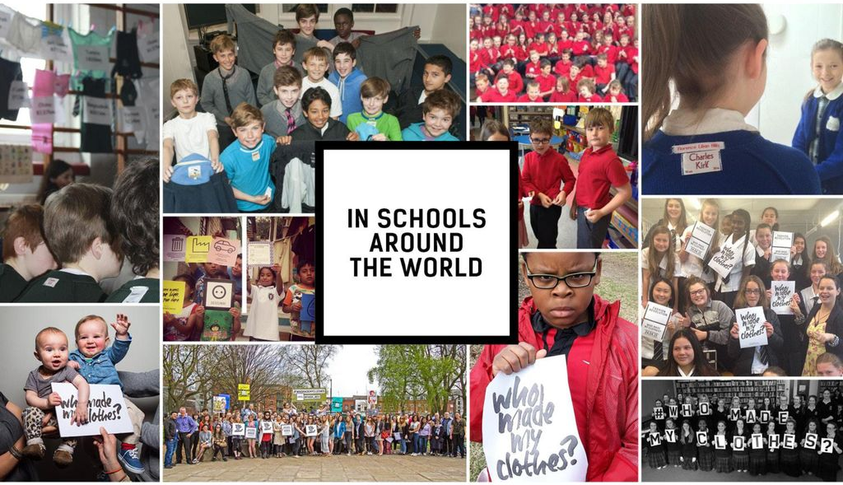
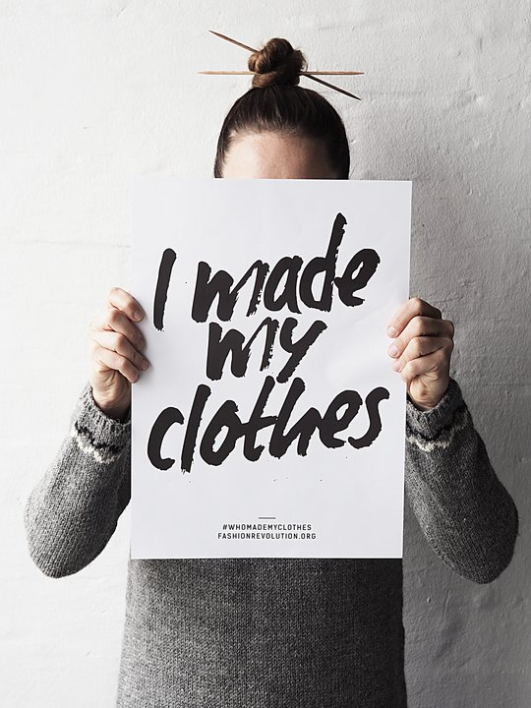
Notes:
Fashion Revolution Week is celebrated in schools and universities across the world from,primary school children right up to university level. They share their activities on social media using the hashtag #whomademyclothes. (According to the policies of each individual establishment).
Some ways to take part:
Students can send a postcard to their policymaker: https://issuu.com/fashionrevolution/docs/fr_2020_postcard-template
Students can send an email to a brand: https://www.fashionrevolution.org/resources/free-downloads/

Slide 12
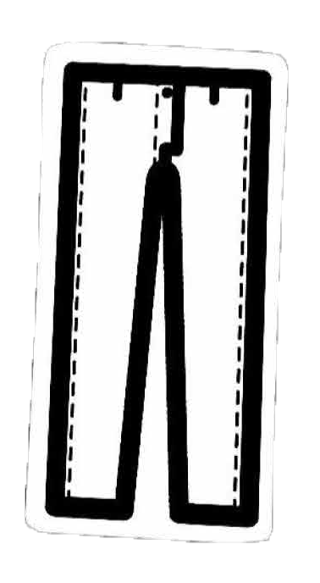
LET’S USE OUR CREATIVITY TO MAKE FASHION BETTER FOR EVERYONE!
www.fashionrevolution.org
Notes:
Learn more at www.fashionrevolution.org

